Slide 1
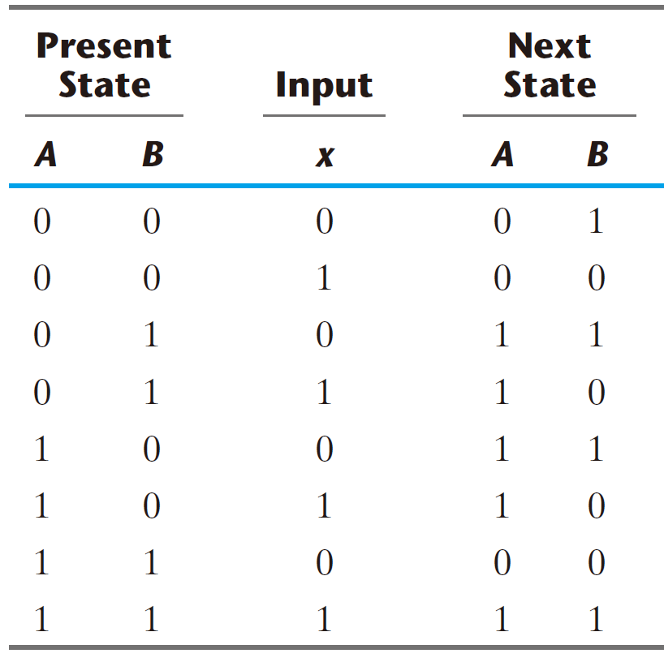
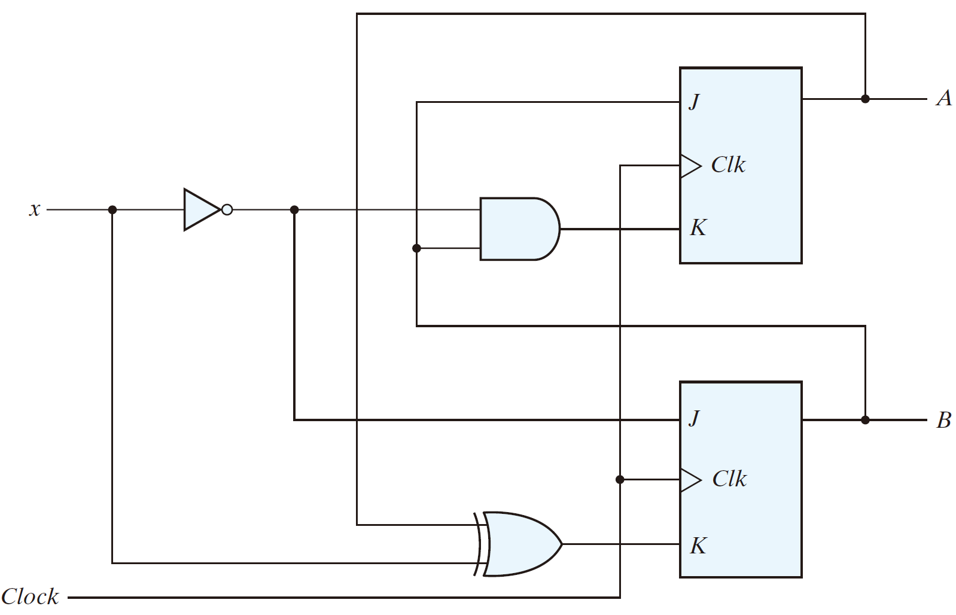
Analysis with JK Flip-Flops

Slide 2
Analysis with JK Flip-Flops
Present State |  | Input | Next State |  | Flip-Flop Inputs
A | B | x | A | B | J_{A} | K_{A} | J_{B} | K_{B}

Slide 3
Analysis with JK Flip-Flops
Present State |  | Input | Next State |  | Flip-Flop Inputs
A | B | x | A | B | J_{A} | K_{A} | J_{B} | K_{B}
0 | 0 | 0
0 | 0 | 1
0 | 1 | 0
0 | 1 | 1
1 | 0 | 0
1 | 0 | 1
1 | 1 | 0
1 | 1 | 1

Slide 4
Analysis with JK Flip-Flops
The Flip-Flop input equations
Present State |  | Input | Next State |  | Flip-Flop Inputs
A | B | x | A | B | J_{A} | K_{A} | J_{B} | K_{B}
0 | 0 | 0
0 | 0 | 1
0 | 1 | 0
0 | 1 | 1
1 | 0 | 0
1 | 0 | 1
1 | 1 | 0
1 | 1 | 1

Slide 5
Analysis with JK Flip-Flops
The Flip-Flop input equations
J_{A} = B
Present State |  | Input | Next State |  | Flip-Flop Inputs
A | B | x | A | B | J_{A} | K_{A} | J_{B} | K_{B}
0 | 0 | 0
0 | 0 | 1
0 | 1 | 0
0 | 1 | 1
1 | 0 | 0
1 | 0 | 1
1 | 1 | 0
1 | 1 | 1

Slide 6
Analysis with JK Flip-Flops
The Flip-Flop input equations
J_{A} = B
Present State |  | Input | Next State |  | Flip-Flop Inputs
A | B | x | A | B | J_{A} | K_{A} | J_{B} | K_{B}
0 | 0 | 0 |  |  | 0
0 | 0 | 1 |  |  | 0
0 | 1 | 0 |  |  | 1
0 | 1 | 1 |  |  | 1
1 | 0 | 0 |  |  | 0
1 | 0 | 1 |  |  | 0
1 | 1 | 0 |  |  | 1
1 | 1 | 1 |  |  | 1

Slide 7
Analysis with JK Flip-Flops
The Flip-Flop input equations
J_{A} = B
K_{A} = Bx’
Present State |  | Input | Next State |  | Flip-Flop Inputs
A | B | x | A | B | J_{A} | K_{A} | J_{B} | K_{B}
0 | 0 | 0 |  |  | 0
0 | 0 | 1 |  |  | 0
0 | 1 | 0 |  |  | 1
0 | 1 | 1 |  |  | 1
1 | 0 | 0 |  |  | 0
1 | 0 | 1 |  |  | 0
1 | 1 | 0 |  |  | 1
1 | 1 | 1 |  |  | 1

Slide 8
Analysis with JK Flip-Flops
The Flip-Flop input equations
J_{A} = B
K_{A} = Bx’
Present State |  | Input | Next State |  | Flip-Flop Inputs
A | B | x | A | B | J_{A} | K_{A} | J_{B} | K_{B}
0 | 0 | 0 |  |  | 0
0 | 0 | 1 |  |  | 0
0 | 1 | 0 |  |  | 1 | 1
0 | 1 | 1 |  |  | 1
1 | 0 | 0 |  |  | 0
1 | 0 | 1 |  |  | 0
1 | 1 | 0 |  |  | 1 | 1
1 | 1 | 1 |  |  | 1

Slide 9
Analysis with JK Flip-Flops
The Flip-Flop input equations
J_{A} = B
K_{A} = Bx’
Present State |  | Input | Next State |  | Flip-Flop Inputs
A | B | x | A | B | J_{A} | K_{A} | J_{B} | K_{B}
0 | 0 | 0 |  |  | 0 | 0
0 | 0 | 1 |  |  | 0 | 0
0 | 1 | 0 |  |  | 1 | 1
0 | 1 | 1 |  |  | 1 | 0
1 | 0 | 0 |  |  | 0 | 0
1 | 0 | 1 |  |  | 0 | 0
1 | 1 | 0 |  |  | 1 | 1
1 | 1 | 1 |  |  | 1 | 0

Slide 10
Analysis with JK Flip-Flops
The Flip-Flop input equations
J_{A} = B
K_{A} = Bx’
J_{B} = x’
Present State |  | Input | Next State |  | Flip-Flop Inputs
A | B | x | A | B | J_{A} | K_{A} | J_{B} | K_{B}
0 | 0 | 0 |  |  | 0 | 0
0 | 0 | 1 |  |  | 0 | 0
0 | 1 | 0 |  |  | 1 | 1
0 | 1 | 1 |  |  | 1 | 0
1 | 0 | 0 |  |  | 0 | 0
1 | 0 | 1 |  |  | 0 | 0
1 | 1 | 0 |  |  | 1 | 1
1 | 1 | 1 |  |  | 1 | 0

Slide 11
Analysis with JK Flip-Flops
The Flip-Flop input equations
J_{A} = B
K_{A} = Bx’
J_{B} = x’
Present State |  | Input | Next State |  | Flip-Flop Inputs
A | B | x | A | B | J_{A} | K_{A} | J_{B} | K_{B}
0 | 0 | 0 |  |  | 0 | 0 | 1
0 | 0 | 1 |  |  | 0 | 0 | 0
0 | 1 | 0 |  |  | 1 | 1 | 1
0 | 1 | 1 |  |  | 1 | 0 | 0
1 | 0 | 0 |  |  | 0 | 0 | 1
1 | 0 | 1 |  |  | 0 | 0 | 0
1 | 1 | 0 |  |  | 1 | 1 | 1
1 | 1 | 1 |  |  | 1 | 0 | 0

Slide 12
Analysis with JK Flip-Flops
The Flip-Flop input equations
J_{A} = B
K_{A} = Bx’
J_{B} = x’
K_{B} = A ⊕ x
Present State |  | Input | Next State |  | Flip-Flop Inputs
A | B | x | A | B | J_{A} | K_{A} | J_{B} | K_{B}
0 | 0 | 0 |  |  | 0 | 0 | 1
0 | 0 | 1 |  |  | 0 | 0 | 0
0 | 1 | 0 |  |  | 1 | 1 | 1
0 | 1 | 1 |  |  | 1 | 0 | 0
1 | 0 | 0 |  |  | 0 | 0 | 1
1 | 0 | 1 |  |  | 0 | 0 | 0
1 | 1 | 0 |  |  | 1 | 1 | 1
1 | 1 | 1 |  |  | 1 | 0 | 0

Slide 13
Analysis with JK Flip-Flops
The Flip-Flop input equations
J_{A} = B
K_{A} = Bx’
J_{B} = x’
K_{B} = A ⊕ x
Present State |  | Input | Next State |  | Flip-Flop Inputs
A | B | x | A | B | J_{A} | K_{A} | J_{B} | K_{B}
0 | 0 | 0 |  |  | 0 | 0 | 1 | 0
0 | 0 | 1 |  |  | 0 | 0 | 0 | 1
0 | 1 | 0 |  |  | 1 | 1 | 1 | 0
0 | 1 | 1 |  |  | 1 | 0 | 0 | 1
1 | 0 | 0 |  |  | 0 | 0 | 1 | 1
1 | 0 | 1 |  |  | 0 | 0 | 0 | 0
1 | 1 | 0 |  |  | 1 | 1 | 1 | 1
1 | 1 | 1 |  |  | 1 | 0 | 0 | 0

Slide 14
Analysis with JK Flip-Flops
The Flip-Flop input equations
J_{A} = B
K_{A} = Bx’
J_{B} = x’
K_{B} = A ⊕ x
Present State |  | Input | Next State |  | Flip-Flop Inputs
A | B | x | A | B | J_{A} | K_{A} | J_{B} | K_{B}
0 | 0 | 0 |  |  | 0 | 0 | 1 | 0
0 | 0 | 1 |  |  | 0 | 0 | 0 | 1
0 | 1 | 0 |  |  | 1 | 1 | 1 | 0
0 | 1 | 1 |  |  | 1 | 0 | 0 | 1
1 | 0 | 0 |  |  | 0 | 0 | 1 | 1
1 | 0 | 1 |  |  | 0 | 0 | 0 | 0
1 | 1 | 0 |  |  | 1 | 1 | 1 | 1
1 | 1 | 1 |  |  | 1 | 0 | 0 | 0

Slide 15
Analysis with JK Flip-Flops
The Flip-Flop input equations
J_{A} = B
K_{A} = Bx’
J_{B} = x’
K_{B} = A ⊕ x
Present State |  | Input | Next State |  | Flip-Flop Inputs
A | B | x | A | B | J_{A} | K_{A} | J_{B} | K_{B}
0 | 0 | 0 | 0 |  | 0 | 0 | 1 | 0
0 | 0 | 1 |  |  | 0 | 0 | 0 | 1
0 | 1 | 0 |  |  | 1 | 1 | 1 | 0
0 | 1 | 1 |  |  | 1 | 0 | 0 | 1
1 | 0 | 0 |  |  | 0 | 0 | 1 | 1
1 | 0 | 1 |  |  | 0 | 0 | 0 | 0
1 | 1 | 0 |  |  | 1 | 1 | 1 | 1
1 | 1 | 1 |  |  | 1 | 0 | 0 | 0

Slide 16
Analysis with JK Flip-Flops
The Flip-Flop input equations
J_{A} = B
K_{A} = Bx’
J_{B} = x’
K_{B} = A ⊕ x
Present State |  | Input | Next State |  | Flip-Flop Inputs
A | B | x | A | B | J_{A} | K_{A} | J_{B} | K_{B}
0 | 0 | 0 | 0 |  | 0 | 0 | 1 | 0
0 | 0 | 1 |  |  | 0 | 0 | 0 | 1
0 | 1 | 0 |  |  | 1 | 1 | 1 | 0
0 | 1 | 1 |  |  | 1 | 0 | 0 | 1
1 | 0 | 0 |  |  | 0 | 0 | 1 | 1
1 | 0 | 1 |  |  | 0 | 0 | 0 | 0
1 | 1 | 0 |  |  | 1 | 1 | 1 | 1
1 | 1 | 1 |  |  | 1 | 0 | 0 | 0

Slide 17
Analysis with JK Flip-Flops
The Flip-Flop input equations
J_{A} = B
K_{A} = Bx’
J_{B} = x’
K_{B} = A ⊕ x
Present State |  | Input | Next State |  | Flip-Flop Inputs
A | B | x | A | B | J_{A} | K_{A} | J_{B} | K_{B}
0 | 0 | 0 | 0 |  | 0 | 0 | 1 | 0
0 | 0 | 1 | 0 |  | 0 | 0 | 0 | 1
0 | 1 | 0 |  |  | 1 | 1 | 1 | 0
0 | 1 | 1 |  |  | 1 | 0 | 0 | 1
1 | 0 | 0 |  |  | 0 | 0 | 1 | 1
1 | 0 | 1 |  |  | 0 | 0 | 0 | 0
1 | 1 | 0 |  |  | 1 | 1 | 1 | 1
1 | 1 | 1 |  |  | 1 | 0 | 0 | 0

Slide 18
Analysis with JK Flip-Flops
The Flip-Flop input equations
J_{A} = B
K_{A} = Bx’
J_{B} = x’
K_{B} = A ⊕ x
Present State |  | Input | Next State |  | Flip-Flop Inputs
A | B | x | A | B | J_{A} | K_{A} | J_{B} | K_{B}
0 | 0 | 0 | 0 |  | 0 | 0 | 1 | 0
0 | 0 | 1 | 0 |  | 0 | 0 | 0 | 1
0 | 1 | 0 |  |  | 1 | 1 | 1 | 0
0 | 1 | 1 |  |  | 1 | 0 | 0 | 1
1 | 0 | 0 |  |  | 0 | 0 | 1 | 1
1 | 0 | 1 |  |  | 0 | 0 | 0 | 0
1 | 1 | 0 |  |  | 1 | 1 | 1 | 1
1 | 1 | 1 |  |  | 1 | 0 | 0 | 0

Slide 19
Analysis with JK Flip-Flops
The Flip-Flop input equations
J_{A} = B
K_{A} = Bx’
J_{B} = x’
K_{B} = A ⊕ x
Present State |  | Input | Next State |  | Flip-Flop Inputs
A | B | x | A | B | J_{A} | K_{A} | J_{B} | K_{B}
0 | 0 | 0 | 0 |  | 0 | 0 | 1 | 0
0 | 0 | 1 | 0 |  | 0 | 0 | 0 | 1
0 | 1 | 0 | 1 |  | 1 | 1 | 1 | 0
0 | 1 | 1 |  |  | 1 | 0 | 0 | 1
1 | 0 | 0 |  |  | 0 | 0 | 1 | 1
1 | 0 | 1 |  |  | 0 | 0 | 0 | 0
1 | 1 | 0 |  |  | 1 | 1 | 1 | 1
1 | 1 | 1 |  |  | 1 | 0 | 0 | 0

Slide 20
Analysis with JK Flip-Flops
The Flip-Flop input equations
J_{A} = B
K_{A} = Bx’
J_{B} = x’
K_{B} = A ⊕ x
Present State |  | Input | Next State |  | Flip-Flop Inputs
A | B | x | A | B | J_{A} | K_{A} | J_{B} | K_{B}
0 | 0 | 0 | 0 |  | 0 | 0 | 1 | 0
0 | 0 | 1 | 0 |  | 0 | 0 | 0 | 1
0 | 1 | 0 | 1 |  | 1 | 1 | 1 | 0
0 | 1 | 1 |  |  | 1 | 0 | 0 | 1
1 | 0 | 0 |  |  | 0 | 0 | 1 | 1
1 | 0 | 1 |  |  | 0 | 0 | 0 | 0
1 | 1 | 0 |  |  | 1 | 1 | 1 | 1
1 | 1 | 1 |  |  | 1 | 0 | 0 | 0

Slide 21
Analysis with JK Flip-Flops
The Flip-Flop input equations
J_{A} = B
K_{A} = Bx’
J_{B} = x’
K_{B} = A ⊕ x
Present State |  | Input | Next State |  | Flip-Flop Inputs
A | B | x | A | B | J_{A} | K_{A} | J_{B} | K_{B}
0 | 0 | 0 | 0 |  | 0 | 0 | 1 | 0
0 | 0 | 1 | 0 |  | 0 | 0 | 0 | 1
0 | 1 | 0 | 1 |  | 1 | 1 | 1 | 0
0 | 1 | 1 | 1 |  | 1 | 0 | 0 | 1
1 | 0 | 0 |  |  | 0 | 0 | 1 | 1
1 | 0 | 1 |  |  | 0 | 0 | 0 | 0
1 | 1 | 0 |  |  | 1 | 1 | 1 | 1
1 | 1 | 1 |  |  | 1 | 0 | 0 | 0

Slide 22
Analysis with JK Flip-Flops
The Flip-Flop input equations
J_{A} = B
K_{A} = Bx’
J_{B} = x’
K_{B} = A ⊕ x
Present State |  | Input | Next State |  | Flip-Flop Inputs
A | B | x | A | B | J_{A} | K_{A} | J_{B} | K_{B}
0 | 0 | 0 | 0 |  | 0 | 0 | 1 | 0
0 | 0 | 1 | 0 |  | 0 | 0 | 0 | 1
0 | 1 | 0 | 1 |  | 1 | 1 | 1 | 0
0 | 1 | 1 | 1 |  | 1 | 0 | 0 | 1
1 | 0 | 0 |  |  | 0 | 0 | 1 | 1
1 | 0 | 1 |  |  | 0 | 0 | 0 | 0
1 | 1 | 0 |  |  | 1 | 1 | 1 | 1
1 | 1 | 1 |  |  | 1 | 0 | 0 | 0

Slide 23
Analysis with JK Flip-Flops
The Flip-Flop input equations
J_{A} = B
K_{A} = Bx’
J_{B} = x’
K_{B} = A ⊕ x
Present State |  | Input | Next State |  | Flip-Flop Inputs
A | B | x | A | B | J_{A} | K_{A} | J_{B} | K_{B}
0 | 0 | 0 | 0 |  | 0 | 0 | 1 | 0
0 | 0 | 1 | 0 |  | 0 | 0 | 0 | 1
0 | 1 | 0 | 1 |  | 1 | 1 | 1 | 0
0 | 1 | 1 | 1 |  | 1 | 0 | 0 | 1
1 | 0 | 0 | 1 |  | 0 | 0 | 1 | 1
1 | 0 | 1 |  |  | 0 | 0 | 0 | 0
1 | 1 | 0 |  |  | 1 | 1 | 1 | 1
1 | 1 | 1 |  |  | 1 | 0 | 0 | 0

Slide 24
Analysis with JK Flip-Flops
The Flip-Flop input equations
J_{A} = B
K_{A} = Bx’
J_{B} = x’
K_{B} = A ⊕ x
Present State |  | Input | Next State |  | Flip-Flop Inputs
A | B | x | A | B | J_{A} | K_{A} | J_{B} | K_{B}
0 | 0 | 0 | 0 |  | 0 | 0 | 1 | 0
0 | 0 | 1 | 0 |  | 0 | 0 | 0 | 1
0 | 1 | 0 | 1 |  | 1 | 1 | 1 | 0
0 | 1 | 1 | 1 |  | 1 | 0 | 0 | 1
1 | 0 | 0 | 1 |  | 0 | 0 | 1 | 1
1 | 0 | 1 |  |  | 0 | 0 | 0 | 0
1 | 1 | 0 |  |  | 1 | 1 | 1 | 1
1 | 1 | 1 |  |  | 1 | 0 | 0 | 0

Slide 25
Analysis with JK Flip-Flops
The Flip-Flop input equations
J_{A} = B
K_{A} = Bx’
J_{B} = x’
K_{B} = A ⊕ x
Present State |  | Input | Next State |  | Flip-Flop Inputs
A | B | x | A | B | J_{A} | K_{A} | J_{B} | K_{B}
0 | 0 | 0 | 0 |  | 0 | 0 | 1 | 0
0 | 0 | 1 | 0 |  | 0 | 0 | 0 | 1
0 | 1 | 0 | 1 |  | 1 | 1 | 1 | 0
0 | 1 | 1 | 1 |  | 1 | 0 | 0 | 1
1 | 0 | 0 | 1 |  | 0 | 0 | 1 | 1
1 | 0 | 1 | 1 |  | 0 | 0 | 0 | 0
1 | 1 | 0 |  |  | 1 | 1 | 1 | 1
1 | 1 | 1 |  |  | 1 | 0 | 0 | 0

Slide 26
Analysis with JK Flip-Flops
The Flip-Flop input equations
J_{A} = B
K_{A} = Bx’
J_{B} = x’
K_{B} = A ⊕ x
Present State |  | Input | Next State |  | Flip-Flop Inputs
A | B | x | A | B | J_{A} | K_{A} | J_{B} | K_{B}
0 | 0 | 0 | 0 |  | 0 | 0 | 1 | 0
0 | 0 | 1 | 0 |  | 0 | 0 | 0 | 1
0 | 1 | 0 | 1 |  | 1 | 1 | 1 | 0
0 | 1 | 1 | 1 |  | 1 | 0 | 0 | 1
1 | 0 | 0 | 1 |  | 0 | 0 | 1 | 1
1 | 0 | 1 | 1 |  | 0 | 0 | 0 | 0
1 | 1 | 0 |  |  | 1 | 1 | 1 | 1
1 | 1 | 1 |  |  | 1 | 0 | 0 | 0

Slide 27
Analysis with JK Flip-Flops
The Flip-Flop input equations
J_{A} = B
K_{A} = Bx’
J_{B} = x’
K_{B} = A ⊕ x
Present State |  | Input | Next State |  | Flip-Flop Inputs
A | B | x | A | B | J_{A} | K_{A} | J_{B} | K_{B}
0 | 0 | 0 | 0 |  | 0 | 0 | 1 | 0
0 | 0 | 1 | 0 |  | 0 | 0 | 0 | 1
0 | 1 | 0 | 1 |  | 1 | 1 | 1 | 0
0 | 1 | 1 | 1 |  | 1 | 0 | 0 | 1
1 | 0 | 0 | 1 |  | 0 | 0 | 1 | 1
1 | 0 | 1 | 1 |  | 0 | 0 | 0 | 0
1 | 1 | 0 | 0 |  | 1 | 1 | 1 | 1
1 | 1 | 1 |  |  | 1 | 0 | 0 | 0

Slide 28
Analysis with JK Flip-Flops
The Flip-Flop input equations
J_{A} = B
K_{A} = Bx’
J_{B} = x’
K_{B} = A ⊕ x
Present State |  | Input | Next State |  | Flip-Flop Inputs
A | B | x | A | B | J_{A} | K_{A} | J_{B} | K_{B}
0 | 0 | 0 | 0 |  | 0 | 0 | 1 | 0
0 | 0 | 1 | 0 |  | 0 | 0 | 0 | 1
0 | 1 | 0 | 1 |  | 1 | 1 | 1 | 0
0 | 1 | 1 | 1 |  | 1 | 0 | 0 | 1
1 | 0 | 0 | 1 |  | 0 | 0 | 1 | 1
1 | 0 | 1 | 1 |  | 0 | 0 | 0 | 0
1 | 1 | 0 | 0 |  | 1 | 1 | 1 | 1
1 | 1 | 1 |  |  | 1 | 0 | 0 | 0

Slide 29
Analysis with JK Flip-Flops
The Flip-Flop input equations
J_{A} = B
K_{A} = Bx’
J_{B} = x’
K_{B} = A ⊕ x
Present State |  | Input | Next State |  | Flip-Flop Inputs
A | B | x | A | B | J_{A} | K_{A} | J_{B} | K_{B}
0 | 0 | 0 | 0 |  | 0 | 0 | 1 | 0
0 | 0 | 1 | 0 |  | 0 | 0 | 0 | 1
0 | 1 | 0 | 1 |  | 1 | 1 | 1 | 0
0 | 1 | 1 | 1 |  | 1 | 0 | 0 | 1
1 | 0 | 0 | 1 |  | 0 | 0 | 1 | 1
1 | 0 | 1 | 1 |  | 0 | 0 | 0 | 0
1 | 1 | 0 | 0 |  | 1 | 1 | 1 | 1
1 | 1 | 1 | 1 |  | 1 | 0 | 0 | 0

Slide 30
Analysis with JK Flip-Flops
The Flip-Flop input equations
J_{A} = B
K_{A} = Bx’
J_{B} = x’
K_{B} = A ⊕ x
Present State |  | Input | Next State |  | Flip-Flop Inputs
A | B | x | A | B | J_{A} | K_{A} | J_{B} | K_{B}
0 | 0 | 0 | 0 |  | 0 | 0 | 1 | 0
0 | 0 | 1 | 0 |  | 0 | 0 | 0 | 1
0 | 1 | 0 | 1 |  | 1 | 1 | 1 | 0
0 | 1 | 1 | 1 |  | 1 | 0 | 0 | 1
1 | 0 | 0 | 1 |  | 0 | 0 | 1 | 1
1 | 0 | 1 | 1 |  | 0 | 0 | 0 | 0
1 | 1 | 0 | 0 |  | 1 | 1 | 1 | 1
1 | 1 | 1 | 1 |  | 1 | 0 | 0 | 0

Slide 31
Analysis with JK Flip-Flops
The Flip-Flop input equations
J_{A} = B
K_{A} = Bx’
J_{B} = x’
K_{B} = A ⊕ x
Present State |  | Input | Next State |  | Flip-Flop Inputs
A | B | x | A | B | J_{A} | K_{A} | J_{B} | K_{B}
0 | 0 | 0 | 0 |  | 0 | 0 | 1 | 0
0 | 0 | 1 | 0 |  | 0 | 0 | 0 | 1
0 | 1 | 0 | 1 |  | 1 | 1 | 1 | 0
0 | 1 | 1 | 1 |  | 1 | 0 | 0 | 1
1 | 0 | 0 | 1 |  | 0 | 0 | 1 | 1
1 | 0 | 1 | 1 |  | 0 | 0 | 0 | 0
1 | 1 | 0 | 0 |  | 1 | 1 | 1 | 1
1 | 1 | 1 | 1 |  | 1 | 0 | 0 | 0

Slide 32
Analysis with JK Flip-Flops
The Flip-Flop input equations
J_{A} = B
K_{A} = Bx’
J_{B} = x’
K_{B} = A ⊕ x
Present State |  | Input | Next State |  | Flip-Flop Inputs
A | B | x | A | B | J_{A} | K_{A} | J_{B} | K_{B}
0 | 0 | 0 | 0 | 1 | 0 | 0 | 1 | 0
0 | 0 | 1 | 0 | 0 | 0 | 0 | 0 | 1
0 | 1 | 0 | 1 | 1 | 1 | 1 | 1 | 0
0 | 1 | 1 | 1 | 0 | 1 | 0 | 0 | 1
1 | 0 | 0 | 1 | 1 | 0 | 0 | 1 | 1
1 | 0 | 1 | 1 | 0 | 0 | 0 | 0 | 0
1 | 1 | 0 | 0 | 0 | 1 | 1 | 1 | 1
1 | 1 | 1 | 1 | 1 | 1 | 0 | 0 | 0

Slide 33
Analysis with JK Flip-Flops
The Flip-Flop input equations
J_{A} = B
K_{A} = Bx’
J_{B} = x’
K_{B} = A ⊕ x
Present State |  | Input | Next State |  | Flip-Flop Inputs
A | B | x | A | B | J_{A} | K_{A} | J_{B} | K_{B}
0 | 0 | 0 | 0 | 1 | 0 | 0 | 1 | 0
0 | 0 | 1 | 0 | 0 | 0 | 0 | 0 | 1
0 | 1 | 0 | 1 | 1 | 1 | 1 | 1 | 0
0 | 1 | 1 | 1 | 0 | 1 | 0 | 0 | 1
1 | 0 | 0 | 1 | 1 | 0 | 0 | 1 | 1
1 | 0 | 1 | 1 | 0 | 0 | 0 | 0 | 0
1 | 1 | 0 | 0 | 0 | 1 | 1 | 1 | 1
1 | 1 | 1 | 1 | 1 | 1 | 0 | 0 | 0

Slide 34
The Flip-Flop input equations
J_{A} = B
K_{A} = Bx’
J_{B} = x’
K_{B} = A ⊕ x
Present State |  | Input | Next State
A | B | x | A | B
0 | 0 | 0 | 0 | 1
0 | 0 | 1 | 0 | 0
0 | 1 | 0 | 1 | 1
0 | 1 | 1 | 1 | 0
1 | 0 | 0 | 1 | 1
1 | 0 | 1 | 1 | 0
1 | 1 | 0 | 0 | 0
1 | 1 | 1 | 1 | 1

Slide 35
The Flip-Flop input equations
J_{A} = B
K_{A} = Bx’
J_{B} = x’
K_{B} = A ⊕ x
Present State |  | Input | Next State
A | B | x | A | B
0 | 0 | 0
0 | 0 | 1
0 | 1 | 0
0 | 1 | 1
1 | 0 | 0
1 | 0 | 1
1 | 1 | 0
1 | 1 | 1

Slide 36
Characteristic Equations
The Flip-Flop input equations
J_{A} = B
K_{A} = Bx’
    Q(t + 1) = JQ’ + K’Q
J_{B} = x’
K_{B} = A ⊕ x
Present State |  | Input | Next State
A | B | x | A | B
0 | 0 | 0
0 | 0 | 1
0 | 1 | 0
0 | 1 | 1
1 | 0 | 0
1 | 0 | 1
1 | 1 | 0
1 | 1 | 1

Slide 37
Characteristic Equations
The Flip-Flop input equations
J_{A} = B
K_{A} = Bx’
    Q(t + 1) = JQ’ + K’Q
J_{B} = x’
K_{B} = A ⊕ x
    A(t + 1) = JA’ + K’A
Present State |  | Input | Next State
A | B | x | A | B
0 | 0 | 0
0 | 0 | 1
0 | 1 | 0
0 | 1 | 1
1 | 0 | 0
1 | 0 | 1
1 | 1 | 0
1 | 1 | 1

Slide 38
Characteristic Equations
The Flip-Flop input equations
J_{A} = B
K_{A} = Bx’
    Q(t + 1) = JQ’ + K’Q
J_{B} = x’
K_{B} = A ⊕ x
    A(t + 1) = JA’ + K’A
Present State |  | Input | Next State
A | B | x | A | B
0 | 0 | 0
0 | 0 | 1
0 | 1 | 0
0 | 1 | 1
1 | 0 | 0
1 | 0 | 1
1 | 1 | 0
1 | 1 | 1
    A(t + 1) = BA‘ + (Bx’)’A

Slide 39
Characteristic Equations
The Flip-Flop input equations
J_{A} = B
K_{A} = Bx’
    Q(t + 1) = JQ’ + K’Q
J_{B} = x’
K_{B} = A ⊕ x
    A(t + 1) = JA’ + K’A
Present State |  | Input | Next State
A | B | x | A | B
0 | 0 | 0
0 | 0 | 1
0 | 1 | 0
0 | 1 | 1
1 | 0 | 0
1 | 0 | 1
1 | 1 | 0
1 | 1 | 1
    A(t + 1) = BA‘ + (Bx’)’A
    = BA‘ + B’A + Ax
    = A⊕B + Ax

Slide 40
Characteristic Equations
The Flip-Flop input equations
J_{A} = B
K_{A} = Bx’
    Q(t + 1) = JQ’ + K’Q
J_{B} = x’
K_{B} = A ⊕ x
    A(t + 1) = JA’ + K’A
State Equations
Present State |  | Input | Next State
A | B | x | A | B
0 | 0 | 0
0 | 0 | 1
0 | 1 | 0
0 | 1 | 1
1 | 0 | 0
1 | 0 | 1
1 | 1 | 0
1 | 1 | 1
    A(t + 1) = BA‘ + (Bx’)’A
    = BA‘ + B’A + Ax
    = A⊕B + Ax

Slide 41
Characteristic Equations
The Flip-Flop input equations
J_{A} = B
K_{A} = Bx’
    Q(t + 1) = JQ’ + K’Q
J_{B} = x’
K_{B} = A ⊕ x
    A(t + 1) = JA’ + K’A
State Equations
Present State |  | Input | Next State
A | B | x | A | B
0 | 0 | 0
0 | 0 | 1
0 | 1 | 0 | 1
0 | 1 | 1 | 1
1 | 0 | 0 | 1
1 | 0 | 1 | 1
1 | 1 | 0
1 | 1 | 1
    A(t + 1) = BA‘ + (Bx’)’A
    = BA‘ + B’A + Ax
    = A⊕B + Ax

Slide 42
Characteristic Equations
The Flip-Flop input equations
J_{A} = B
K_{A} = Bx’
    Q(t + 1) = JQ’ + K’Q
J_{B} = x’
K_{B} = A ⊕ x
    A(t + 1) = JA’ + K’A
State Equations
Present State |  | Input | Next State
A | B | x | A | B
0 | 0 | 0
0 | 0 | 1
0 | 1 | 0 | 1
0 | 1 | 1 | 1
1 | 0 | 0 | 1
1 | 0 | 1 | 1
1 | 1 | 0
1 | 1 | 1 | 1
    A(t + 1) = BA‘ + (Bx’)’A
    = BA‘ + B’A + Ax
    = A⊕B + Ax

Slide 43
Characteristic Equations
The Flip-Flop input equations
J_{A} = B
K_{A} = Bx’
    Q(t + 1) = JQ’ + K’Q
J_{B} = x’
K_{B} = A ⊕ x
    A(t + 1) = JA’ + K’A
State Equations
Present State |  | Input | Next State
A | B | x | A | B
0 | 0 | 0 | 0
0 | 0 | 1 | 0
0 | 1 | 0 | 1
0 | 1 | 1 | 1
1 | 0 | 0 | 1
1 | 0 | 1 | 1
1 | 1 | 0 | 0
1 | 1 | 1 | 1
    A(t + 1) = BA‘ + (Bx’)’A
    = BA‘ + B’A + Ax
    = A⊕B + Ax

Slide 44
Characteristic Equations
The Flip-Flop input equations
J_{A} = B
K_{A} = Bx’
    Q(t + 1) = JQ’ + K’Q
J_{B} = x’
K_{B} = A ⊕ x
    B(t + 1) = JB’ + K’B
State Equations
Present State |  | Input | Next State
A | B | x | A | B
0 | 0 | 0 | 0
0 | 0 | 1 | 0
0 | 1 | 0 | 1
0 | 1 | 1 | 1
1 | 0 | 0 | 1
1 | 0 | 1 | 1
1 | 1 | 0 | 0
1 | 1 | 1 | 1
    A(t + 1) = BA‘ + (Bx’)’A
    = BA‘ + B’A + Ax
    = A⊕B + Ax

Slide 45
Characteristic Equations
The Flip-Flop input equations
J_{A} = B
K_{A} = Bx’
    Q(t + 1) = JQ’ + K’Q
J_{B} = x’
K_{B} = A ⊕ x
    B(t + 1) = JB’ + K’B
State Equations
Present State |  | Input | Next State
A | B | x | A | B
0 | 0 | 0 | 0
0 | 0 | 1 | 0
0 | 1 | 0 | 1
0 | 1 | 1 | 1
1 | 0 | 0 | 1
1 | 0 | 1 | 1
1 | 1 | 0 | 0
1 | 1 | 1 | 1
    A(t + 1) = BA‘ + (Bx’)’A
    = BA‘ + B’A + Ax
    = A⊕B + Ax
    B(t + 1) = x’B’ + (A ⊕ x)’B

Slide 46
Characteristic Equations
The Flip-Flop input equations
J_{A} = B
K_{A} = Bx’
    Q(t + 1) = JQ’ + K’Q
J_{B} = x’
K_{B} = A ⊕ x
    B(t + 1) = JB’ + K’B
State Equations
Present State |  | Input | Next State
A | B | x | A | B
0 | 0 | 0 | 0 | 1
0 | 0 | 1 | 0
0 | 1 | 0 | 1
0 | 1 | 1 | 1
1 | 0 | 0 | 1 | 1
1 | 0 | 1 | 1
1 | 1 | 0 | 0
1 | 1 | 1 | 1
    A(t + 1) = BA‘ + (Bx’)’A
    = BA‘ + B’A + Ax
    = A⊕B + Ax
    B(t + 1) = B’x’ + (A ⊕ x)’B

Slide 47
Characteristic Equations
The Flip-Flop input equations
J_{A} = B
K_{A} = Bx’
    Q(t + 1) = JQ’ + K’Q
J_{B} = x’
K_{B} = A ⊕ x
    B(t + 1) = JB’ + K’B
State Equations
Present State |  | Input | Next State
A | B | x | A | B
0 | 0 | 0 | 0 | 1
0 | 0 | 1 | 0
0 | 1 | 0 | 1
0 | 1 | 1 | 1
1 | 0 | 0 | 1 | 1
1 | 0 | 1 | 1
1 | 1 | 0 | 0
1 | 1 | 1 | 1
    A(t + 1) = BA‘ + (Bx’)’A
    = BA‘ + B’A + Ax
    = A⊕B + Ax
A ⊕ x
0
1
0
1
1
0
1
0
    B(t + 1) = B’x’ + (A ⊕ x)’B

Slide 48
Characteristic Equations
The Flip-Flop input equations
J_{A} = B
K_{A} = Bx’
    Q(t + 1) = JQ’ + K’Q
J_{B} = x’
K_{B} = A ⊕ x
    B(t + 1) = JB’ + K’B
State Equations
Present State |  | Input | Next State
A | B | x | A | B
0 | 0 | 0 | 0 | 1
0 | 0 | 1 | 0
0 | 1 | 0 | 1
0 | 1 | 1 | 1
1 | 0 | 0 | 1 | 1
1 | 0 | 1 | 1
1 | 1 | 0 | 0
1 | 1 | 1 | 1
    A(t + 1) = BA‘ + (Bx’)’A
    = BA‘ + B’A + Ax
    = A⊕B + Ax
A ⊕ x
0
1
0
1
1
0
1
0
(A ⊕ x)’
1
0
1
0
0
1
0
1
    B(t + 1) = B’x’ + (A ⊕ x)’B

Slide 49
Characteristic Equations
The Flip-Flop input equations
J_{A} = B
K_{A} = Bx’
    Q(t + 1) = JQ’ + K’Q
J_{B} = x’
K_{B} = A ⊕ x
    B(t + 1) = JB’ + K’B
State Equations
Present State |  | Input | Next State
A | B | x | A | B
0 | 0 | 0 | 0 | 1
0 | 0 | 1 | 0
0 | 1 | 0 | 1 | 1
0 | 1 | 1 | 1
1 | 0 | 0 | 1 | 1
1 | 0 | 1 | 1
1 | 1 | 0 | 0
1 | 1 | 1 | 1 | 1
    A(t + 1) = BA‘ + (Bx’)’A
    = BA‘ + B’A + Ax
    = A⊕B + Ax
A ⊕ x
0
1
0
1
1
0
1
0
(A ⊕ x)’
1
0
1
0
0
1
0
1
    B(t + 1) = B’x’ + (A ⊕ x)’B

Slide 50
Characteristic Equations
The Flip-Flop input equations
J_{A} = B
K_{A} = Bx’
    Q(t + 1) = JQ’ + K’Q
J_{B} = x’
K_{B} = A ⊕ x
    B(t + 1) = JB’ + K’B
State Equations
Present State |  | Input | Next State
A | B | x | A | B
0 | 0 | 0 | 0 | 1
0 | 0 | 1 | 0 | 0
0 | 1 | 0 | 1 | 1
0 | 1 | 1 | 1 | 0
1 | 0 | 0 | 1 | 1
1 | 0 | 1 | 1 | 0
1 | 1 | 0 | 0 | 0
1 | 1 | 1 | 1 | 1
    A(t + 1) = BA‘ + (Bx’)’A
    = BA‘ + B’A + Ax
    = A⊕B + Ax
A ⊕ x
0
1
0
1
1
0
1
0
(A ⊕ x)’
1
0
1
0
0
1
0
1
    B(t + 1) = B’x’ + (A ⊕ x)’B

Slide 51
Characteristic Equations
The Flip-Flop input equations
J_{A} = B
K_{A} = Bx’
    Q(t + 1) = JQ’ + K’Q
J_{B} = x’
K_{B} = A ⊕ x
    B(t + 1) = JB’ + K’B
State Equations
Present State |  | Input | Next State
A | B | x | A | B
0 | 0 | 0 | 0 | 1
0 | 0 | 1 | 0 | 0
0 | 1 | 0 | 1 | 1
0 | 1 | 1 | 1 | 0
1 | 0 | 0 | 1 | 1
1 | 0 | 1 | 1 | 0
1 | 1 | 0 | 0 | 0
1 | 1 | 1 | 1 | 1
    A(t + 1) = BA‘ + (Bx’)’A
    = BA‘ + B’A + Ax
    = A⊕B + Ax
    B(t + 1) = B’x’ + (A ⊕ x)’B

Slide 52
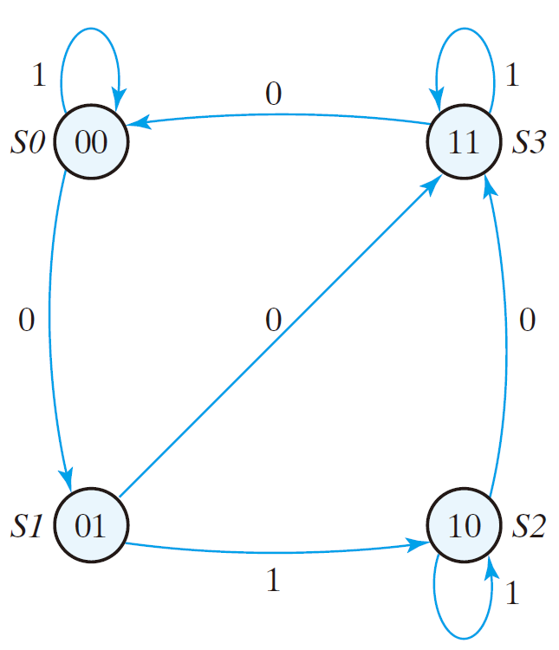
Present State |  | Input | Next State
A | B | x | A | B
0 | 0 | 0 | 0 | 1
0 | 0 | 1 | 0 | 0
0 | 1 | 0 | 1 | 1
0 | 1 | 1 | 1 | 0
1 | 0 | 0 | 1 | 1
1 | 0 | 1 | 1 | 0
1 | 1 | 0 | 0 | 0
1 | 1 | 1 | 1 | 1

Slide 53
Present State |  | Input | Next State
A | B | x | A | B
0 | 0 | 0 | 0 | 1
0 | 0 | 1 | 0 | 0
0 | 1 | 0 | 1 | 1
0 | 1 | 1 | 1 | 0
1 | 0 | 0 | 1 | 1
1 | 0 | 1 | 1 | 0
1 | 1 | 0 | 0 | 0
1 | 1 | 1 | 1 | 1

Slide 54
Present State |  | Input | Next State
A | B | x | A | B
0 | 0 | 0 | 0 | 1
0 | 0 | 1 | 0 | 0
0 | 1 | 0 | 1 | 1
0 | 1 | 1 | 1 | 0
1 | 0 | 0 | 1 | 1
1 | 0 | 1 | 1 | 0
1 | 1 | 0 | 0 | 0
1 | 1 | 1 | 1 | 1

Slide 55
Present State |  | Input | Next State
A | B | x | A | B
0 | 0 | 0 | 0 | 1
0 | 0 | 1 | 0 | 0
0 | 1 | 0 | 1 | 1
0 | 1 | 1 | 1 | 0
1 | 0 | 0 | 1 | 1
1 | 0 | 1 | 1 | 0
1 | 1 | 0 | 0 | 0
1 | 1 | 1 | 1 | 1

Slide 56
Present State |  | Input | Next State
A | B | x | A | B
0 | 0 | 0 | 0 | 1
0 | 0 | 1 | 0 | 0
0 | 1 | 0 | 1 | 1
0 | 1 | 1 | 1 | 0
1 | 0 | 0 | 1 | 1
1 | 0 | 1 | 1 | 0
1 | 1 | 0 | 0 | 0
1 | 1 | 1 | 1 | 1

Slide 57
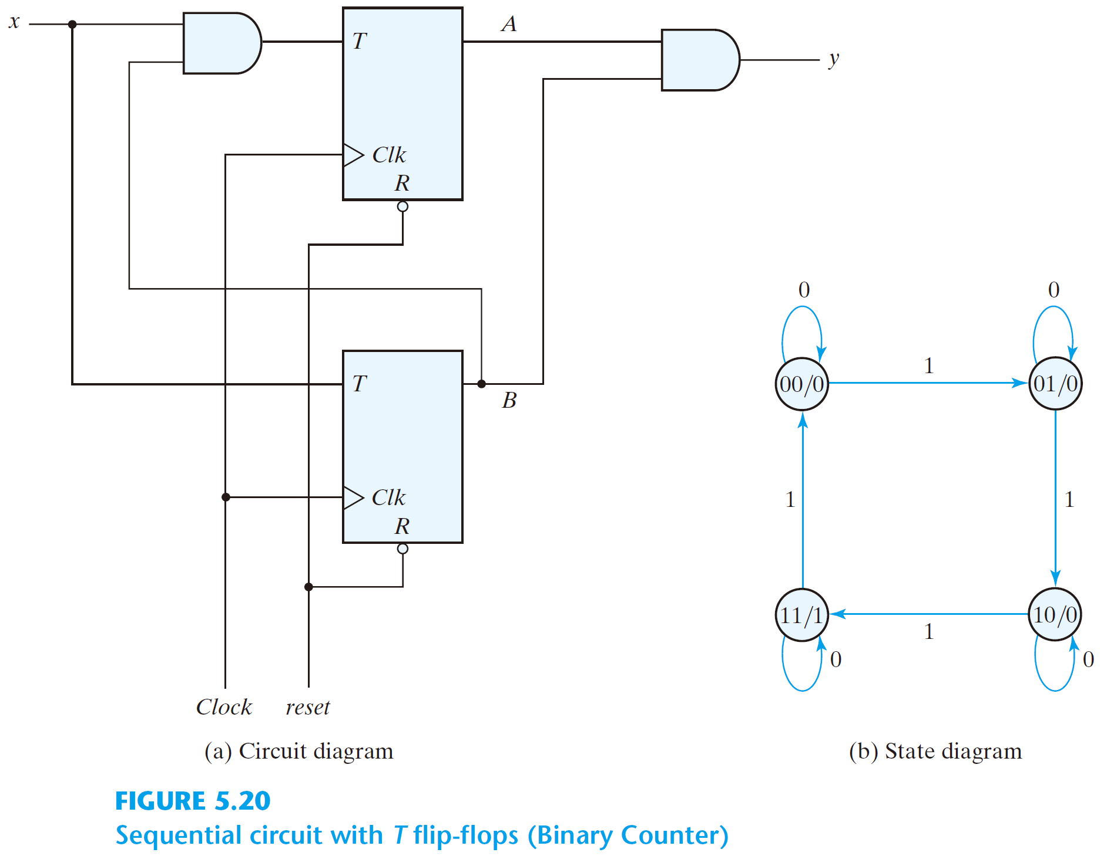
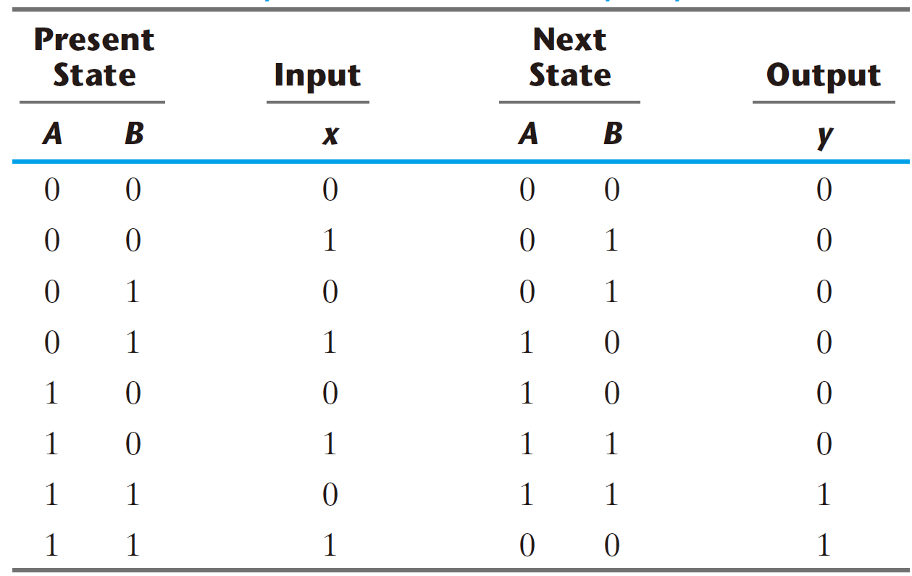
Analysis with T flip-flops

Slide 58
Analysis with T flip-flops
Present State |  | Input | Next State |  | Flip-Flop Inputs |  | Output
A | B | x | A | B | T_{A} | T_{B} | y

Slide 59
Analysis with T flip-flops
Present State |  | Input | Next State |  | Flip-Flop Inputs |  | Output
A | B | x | A | B | T_{A} | T_{B} | y
0 | 0 | 0
0 | 0 | 1
0 | 1 | 0
0 | 1 | 1
1 | 0 | 0
1 | 0 | 1
1 | 1 | 0
1 | 1 | 1

Slide 60
Analysis with T flip-flops
The Output equation
y = AB
Present State |  | Input | Next State |  | Flip-Flop Inputs |  | Output
A | B | x | A | B | T_{A} | T_{B} | y
0 | 0 | 0
0 | 0 | 1
0 | 1 | 0
0 | 1 | 1
1 | 0 | 0
1 | 0 | 1
1 | 1 | 0
1 | 1 | 1

Slide 61
Analysis with T flip-flops
The Output equation
y = AB
Present State |  | Input | Next State |  | Flip-Flop Inputs |  | Output
A | B | x | A | B | T_{A} | T_{B} | y
0 | 0 | 0
0 | 0 | 1
0 | 1 | 0
0 | 1 | 1
1 | 0 | 0
1 | 0 | 1
1 | 1 | 0
1 | 1 | 1

Slide 62
Analysis with T flip-flops
The Output equation
y = AB
Present State |  | Input | Next State |  | Flip-Flop Inputs |  | Output
A | B | x | A | B | T_{A} | T_{B} | y
0 | 0 | 0 |  |  |  |  | 0
0 | 0 | 1 |  |  |  |  | 0
0 | 1 | 0 |  |  |  |  | 0
0 | 1 | 1 |  |  |  |  | 0
1 | 0 | 0 |  |  |  |  | 0
1 | 0 | 1 |  |  |  |  | 0
1 | 1 | 0 |  |  |  |  | 1
1 | 1 | 1 |  |  |  |  | 1

Slide 63
Analysis with T flip-flops
The Flip-Flop input equations
Present State |  | Input | Next State |  | Flip-Flop Inputs |  | Output
A | B | x | A | B | T_{A} | T_{B} | y
0 | 0 | 0 |  |  |  |  | 0
0 | 0 | 1 |  |  |  |  | 0
0 | 1 | 0 |  |  |  |  | 0
0 | 1 | 1 |  |  |  |  | 0
1 | 0 | 0 |  |  |  |  | 0
1 | 0 | 1 |  |  |  |  | 0
1 | 1 | 0 |  |  |  |  | 1
1 | 1 | 1 |  |  |  |  | 1

Slide 64
Analysis with T flip-flops
The Flip-Flop input equations
T_{A} = Bx
Present State |  | Input | Next State |  | Flip-Flop Inputs |  | Output
A | B | x | A | B | T_{A} | T_{B} | y
0 | 0 | 0 |  |  |  |  | 0
0 | 0 | 1 |  |  |  |  | 0
0 | 1 | 0 |  |  |  |  | 0
0 | 1 | 1 |  |  |  |  | 0
1 | 0 | 0 |  |  |  |  | 0
1 | 0 | 1 |  |  |  |  | 0
1 | 1 | 0 |  |  |  |  | 1
1 | 1 | 1 |  |  |  |  | 1

Slide 65
Analysis with T flip-flops
The Flip-Flop input equations
T_{A} = Bx
Present State |  | Input | Next State |  | Flip-Flop Inputs |  | Output
A | B | x | A | B | T_{A} | T_{B} | y
0 | 0 | 0 |  |  |  |  | 0
0 | 0 | 1 |  |  |  |  | 0
0 | 1 | 0 |  |  |  |  | 0
0 | 1 | 1 |  |  | 1 |  | 0
1 | 0 | 0 |  |  |  |  | 0
1 | 0 | 1 |  |  |  |  | 0
1 | 1 | 0 |  |  |  |  | 1
1 | 1 | 1 |  |  | 1 |  | 1

Slide 66
Analysis with T flip-flops
The Flip-Flop input equations
T_{A} = Bx
Present State |  | Input | Next State |  | Flip-Flop Inputs |  | Output
A | B | x | A | B | T_{A} | T_{B} | y
0 | 0 | 0 |  |  | 0 |  | 0
0 | 0 | 1 |  |  | 0 |  | 0
0 | 1 | 0 |  |  | 0 |  | 0
0 | 1 | 1 |  |  | 1 |  | 0
1 | 0 | 0 |  |  | 0 |  | 0
1 | 0 | 1 |  |  | 0 |  | 0
1 | 1 | 0 |  |  | 0 |  | 1
1 | 1 | 1 |  |  | 1 |  | 1

Slide 67
Analysis with T flip-flops
The Flip-Flop input equations
T_{A} = Bx
T_{B} = x
Present State |  | Input | Next State |  | Flip-Flop Inputs |  | Output
A | B | x | A | B | T_{A} | T_{B} | y
0 | 0 | 0 |  |  | 0 |  | 0
0 | 0 | 1 |  |  | 0 |  | 0
0 | 1 | 0 |  |  | 0 |  | 0
0 | 1 | 1 |  |  | 1 |  | 0
1 | 0 | 0 |  |  | 0 |  | 0
1 | 0 | 1 |  |  | 0 |  | 0
1 | 1 | 0 |  |  | 0 |  | 1
1 | 1 | 1 |  |  | 1 |  | 1

Slide 68
Analysis with T flip-flops
The Flip-Flop input equations
T_{A} = Bx
T_{B} = x
Present State |  | Input | Next State |  | Flip-Flop Inputs |  | Output
A | B | x | A | B | T_{A} | T_{B} | y
0 | 0 | 0 |  |  | 0 | 0 | 0
0 | 0 | 1 |  |  | 0 | 1 | 0
0 | 1 | 0 |  |  | 0 | 0 | 0
0 | 1 | 1 |  |  | 1 | 1 | 0
1 | 0 | 0 |  |  | 0 | 0 | 0
1 | 0 | 1 |  |  | 0 | 1 | 0
1 | 1 | 0 |  |  | 0 | 0 | 1
1 | 1 | 1 |  |  | 1 | 1 | 1

Slide 69
Analysis with T flip-flops
The Flip-Flop input equations
T_{A} = Bx
T_{B} = x
Present State |  | Input | Next State |  | Flip-Flop Inputs |  | Output
A | B | x | A | B | T_{A} | T_{B} | y
0 | 0 | 0 |  |  | 0 | 0 | 0
0 | 0 | 1 |  |  | 0 | 1 | 0
0 | 1 | 0 |  |  | 0 | 0 | 0
0 | 1 | 1 |  |  | 1 | 1 | 0
1 | 0 | 0 |  |  | 0 | 0 | 0
1 | 0 | 1 |  |  | 0 | 1 | 0
1 | 1 | 0 |  |  | 0 | 0 | 1
1 | 1 | 1 |  |  | 1 | 1 | 1

Slide 70
Analysis with T flip-flops
The Flip-Flop input equations
T_{A} = Bx
T_{B} = x
Present State |  | Input | Next State |  | Flip-Flop Inputs |  | Output
A | B | x | A | B | T_{A} | T_{B} | y
0 | 0 | 0 | 0 |  | 0 | 0 | 0
0 | 0 | 1 | 0 |  | 0 | 1 | 0
0 | 1 | 0 | 0 |  | 0 | 0 | 0
0 | 1 | 1 | 1 |  | 1 | 1 | 0
1 | 0 | 0 | 1 |  | 0 | 0 | 0
1 | 0 | 1 | 1 |  | 0 | 1 | 0
1 | 1 | 0 | 1 |  | 0 | 0 | 1
1 | 1 | 1 | 0 |  | 1 | 1 | 1

Slide 71
Analysis with T flip-flops
The Flip-Flop input equations
T_{A} = Bx
T_{B} = x
Present State |  | Input | Next State |  | Flip-Flop Inputs |  | Output
A | B | x | A | B | T_{A} | T_{B} | y
0 | 0 | 0 | 0 |  | 0 | 0 | 0
0 | 0 | 1 | 0 |  | 0 | 1 | 0
0 | 1 | 0 | 0 |  | 0 | 0 | 0
0 | 1 | 1 | 1 |  | 1 | 1 | 0
1 | 0 | 0 | 1 |  | 0 | 0 | 0
1 | 0 | 1 | 1 |  | 0 | 1 | 0
1 | 1 | 0 | 1 |  | 0 | 0 | 1
1 | 1 | 1 | 0 |  | 1 | 1 | 1

Slide 72
Analysis with T flip-flops
The Flip-Flop input equations
T_{A} = Bx
T_{B} = x
Present State |  | Input | Next State |  | Flip-Flop Inputs |  | Output
A | B | x | A | B | T_{A} | T_{B} | y
0 | 0 | 0 | 0 | 0 | 0 | 0 | 0
0 | 0 | 1 | 0 | 1 | 0 | 1 | 0
0 | 1 | 0 | 0 | 1 | 0 | 0 | 0
0 | 1 | 1 | 1 | 0 | 1 | 1 | 0
1 | 0 | 0 | 1 | 0 | 0 | 0 | 0
1 | 0 | 1 | 1 | 1 | 0 | 1 | 0
1 | 1 | 0 | 1 | 1 | 0 | 0 | 1
1 | 1 | 1 | 0 | 0 | 1 | 1 | 1

Slide 73
Analysis with T flip-flops
The Flip-Flop input equations
T_{A} = Bx
T_{B} = x
Present State |  | Input | Next State |  | Flip-Flop Inputs |  | Output
A | B | x | A | B | T_{A} | T_{B} | y
0 | 0 | 0 | 0 | 0 | 0 | 0 | 0
0 | 0 | 1 | 0 | 1 | 0 | 1 | 0
0 | 1 | 0 | 0 | 1 | 0 | 0 | 0
0 | 1 | 1 | 1 | 0 | 1 | 1 | 0
1 | 0 | 0 | 1 | 0 | 0 | 0 | 0
1 | 0 | 1 | 1 | 1 | 0 | 1 | 0
1 | 1 | 0 | 1 | 1 | 0 | 0 | 1
1 | 1 | 1 | 0 | 0 | 1 | 1 | 1

Slide 74
Analysis with T flip-flops
The Flip-Flop input equations
T_{A} = Bx
T_{B} = x
Present State |  | Input | Next State |  | Output
A | B | x | A | B | y
0 | 0 | 0 | 0 | 0 | 0
0 | 0 | 1 | 0 | 1 | 0
0 | 1 | 0 | 0 | 1 | 0
0 | 1 | 1 | 1 | 0 | 0
1 | 0 | 0 | 1 | 0 | 0
1 | 0 | 1 | 1 | 1 | 0
1 | 1 | 0 | 1 | 1 | 1
1 | 1 | 1 | 0 | 0 | 1

Slide 75
Characteristic Equations
The Flip-Flop input equations
T_{A} = Bx
T_{B} = x
  Q(t + 1) = TQ’+T’Q
Present State |  | Input | Next State |  | Output
A | B | x | A | B | y
0 | 0 | 0 |  |  | 0
0 | 0 | 1 |  |  | 0
0 | 1 | 0 |  |  | 0
0 | 1 | 1 |  |  | 0
1 | 0 | 0 |  |  | 0
1 | 0 | 1 |  |  | 0
1 | 1 | 0 |  |  | 1
1 | 1 | 1 |  |  | 1

Slide 76
Characteristic Equations
The Flip-Flop input equations
T_{A} = Bx
T_{B} = x
  Q(t + 1) = TQ’+T’Q
    A(t + 1) = TA’ + T’A
Present State |  | Input | Next State |  | Output
A | B | x | A | B | y
0 | 0 | 0 |  |  | 0
0 | 0 | 1 |  |  | 0
0 | 1 | 0 |  |  | 0
0 | 1 | 1 |  |  | 0
1 | 0 | 0 |  |  | 0
1 | 0 | 1 |  |  | 0
1 | 1 | 0 |  |  | 1
1 | 1 | 1 |  |  | 1

Slide 77
Characteristic Equations
The Flip-Flop input equations
T_{A} = Bx
T_{B} = x
  Q(t + 1) = TQ’+T’Q
    A(t + 1) = TA’ + T’A
Present State |  | Input | Next State |  | Output
A | B | x | A | B | y
0 | 0 | 0 |  |  | 0
0 | 0 | 1 |  |  | 0
0 | 1 | 0 |  |  | 0
0 | 1 | 1 |  |  | 0
1 | 0 | 0 |  |  | 0
1 | 0 | 1 |  |  | 0
1 | 1 | 0 |  |  | 1
1 | 1 | 1 |  |  | 1
    A(t + 1) = BxA’ + (Bx)’A

Slide 78
Characteristic Equations
The Flip-Flop input equations
T_{A} = Bx
T_{B} = x
  Q(t + 1) = TQ’+T’Q
    A(t + 1) = TA’ + T’A
Present State |  | Input | Next State |  | Output
A | B | x | A | B | y
0 | 0 | 0 |  |  | 0
0 | 0 | 1 |  |  | 0
0 | 1 | 0 |  |  | 0
0 | 1 | 1 |  |  | 0
1 | 0 | 0 |  |  | 0
1 | 0 | 1 |  |  | 0
1 | 1 | 0 |  |  | 1
1 | 1 | 1 |  |  | 1
    A(t + 1) = BxA’ + (Bx)’A
    = A’Bx + AB’ + Ax’

Slide 79
Characteristic Equations
The Flip-Flop input equations
T_{A} = Bx
T_{B} = x
  Q(t + 1) = TQ’+T’Q
    A(t + 1) = TA’ + T’A
State Equations
Present State |  | Input | Next State |  | Output
A | B | x | A | B | y
0 | 0 | 0 |  |  | 0
0 | 0 | 1 |  |  | 0
0 | 1 | 0 |  |  | 0
0 | 1 | 1 |  |  | 0
1 | 0 | 0 |  |  | 0
1 | 0 | 1 |  |  | 0
1 | 1 | 0 |  |  | 1
1 | 1 | 1 |  |  | 1
    A(t + 1) = BxA’ + (Bx)’A
    = A’Bx + AB’ + Ax’

Slide 80
Characteristic Equations
The Flip-Flop input equations
T_{A} = Bx
T_{B} = x
  Q(t + 1) = TQ’+T’Q
    A(t + 1) = TA’ + T’A
State Equations
Present State |  | Input | Next State |  | Output
A | B | x | A | B | y
0 | 0 | 0 | 0 |  | 0
0 | 0 | 1 | 0 |  | 0
0 | 1 | 0 | 0 |  | 0
0 | 1 | 1 | 1 |  | 0
1 | 0 | 0 | 1 |  | 0
1 | 0 | 1 | 1 |  | 0
1 | 1 | 0 | 1 |  | 1
1 | 1 | 1 | 0 |  | 1
    A(t + 1) = BxA’ + (Bx)’A
    = A’Bx + AB’ + Ax’

Slide 81
Characteristic Equations
The Flip-Flop input equations
T_{A} = Bx
T_{B} = x
  Q(t + 1) = TQ’+T’Q
    B(t + 1) = TB’ + T’B
State Equations
Present State |  | Input | Next State |  | Output
A | B | x | A | B | y
0 | 0 | 0 | 0 |  | 0
0 | 0 | 1 | 0 |  | 0
0 | 1 | 0 | 0 |  | 0
0 | 1 | 1 | 1 |  | 0
1 | 0 | 0 | 1 |  | 0
1 | 0 | 1 | 1 |  | 0
1 | 1 | 0 | 1 |  | 1
1 | 1 | 1 | 0 |  | 1
    A(t + 1) = BxA’ + (Bx)’A
    = A’Bx + AB’ + Ax’

Slide 82
Characteristic Equations
The Flip-Flop input equations
T_{A} = Bx
T_{B} = x
  Q(t + 1) = TQ’+T’Q
    B(t + 1) = TB’ + T’B
State Equations
Present State |  | Input | Next State |  | Output
A | B | x | A | B | y
0 | 0 | 0 | 0 |  | 0
0 | 0 | 1 | 0 |  | 0
0 | 1 | 0 | 0 |  | 0
0 | 1 | 1 | 1 |  | 0
1 | 0 | 0 | 1 |  | 0
1 | 0 | 1 | 1 |  | 0
1 | 1 | 0 | 1 |  | 1
1 | 1 | 1 | 0 |  | 1
    A(t + 1) = BxA’ + (Bx)’A
    = A’Bx + AB’ + Ax’
    A(t + 1) = xB’ + x’B
    = B ⊕ x

Slide 83
Characteristic Equations
The Flip-Flop input equations
T_{A} = Bx
T_{B} = x
  Q(t + 1) = TQ’+T’Q
    B(t + 1) = TB’ + T’B
State Equations
Present State |  | Input | Next State |  | Output
A | B | x | A | B | y
0 | 0 | 0 | 0 | 0 | 0
0 | 0 | 1 | 0 | 1 | 0
0 | 1 | 0 | 0 | 1 | 0
0 | 1 | 1 | 1 | 0 | 0
1 | 0 | 0 | 1 | 0 | 0
1 | 0 | 1 | 1 | 1 | 0
1 | 1 | 0 | 1 | 1 | 1
1 | 1 | 1 | 0 | 0 | 1
    A(t + 1) = BxA’ + (Bx)’A
    = A’Bx + AB’ + Ax’
    A(t + 1) = xB’ + x’B
    = B ⊕ x

Slide 84
Present State |  | Input | Next State |  | Output
A | B | x | A | B | y
0 | 0 | 0 | 0 | 0 | 0
0 | 0 | 1 | 0 | 1 | 0
0 | 1 | 0 | 0 | 1 | 0
0 | 1 | 1 | 1 | 0 | 0
1 | 0 | 0 | 1 | 0 | 0
1 | 0 | 1 | 1 | 1 | 0
1 | 1 | 0 | 1 | 1 | 1
1 | 1 | 1 | 0 | 0 | 1

Slide 85
Present State |  | Input | Next State |  | Output
A | B | x | A | B | y
0 | 0 | 0 | 0 | 0 | 0
0 | 0 | 1 | 0 | 1 | 0
0 | 1 | 0 | 0 | 1 | 0
0 | 1 | 1 | 1 | 0 | 0
1 | 0 | 0 | 1 | 0 | 0
1 | 0 | 1 | 1 | 1 | 0
1 | 1 | 0 | 1 | 1 | 1
1 | 1 | 1 | 0 | 0 | 1

Slide 86
Present State |  | Input | Next State |  | Output
A | B | x | A | B | y
0 | 0 | 0 | 0 | 0 | 0
0 | 0 | 1 | 0 | 1 | 0
0 | 1 | 0 | 0 | 1 | 0
0 | 1 | 1 | 1 | 0 | 0
1 | 0 | 0 | 1 | 0 | 0
1 | 0 | 1 | 1 | 1 | 0
1 | 1 | 0 | 1 | 1 | 1
1 | 1 | 1 | 0 | 0 | 1

Slide 87
Present State |  | Input | Next State |  | Output
A | B | x | A | B | y
0 | 0 | 0 | 0 | 0 | 0
0 | 0 | 1 | 0 | 1 | 0
0 | 1 | 0 | 0 | 1 | 0
0 | 1 | 1 | 1 | 0 | 0
1 | 0 | 0 | 1 | 0 | 0
1 | 0 | 1 | 1 | 1 | 0
1 | 1 | 0 | 1 | 1 | 1
1 | 1 | 1 | 0 | 0 | 1

Slide 88
Present State |  | Input | Next State |  | Output
A | B | x | A | B | y
0 | 0 | 0 | 0 | 0 | 0
0 | 0 | 1 | 0 | 1 | 0
0 | 1 | 0 | 0 | 1 | 0
0 | 1 | 1 | 1 | 0 | 0
1 | 0 | 0 | 1 | 0 | 0
1 | 0 | 1 | 1 | 1 | 0
1 | 1 | 0 | 1 | 1 | 1
1 | 1 | 1 | 0 | 0 | 1

Slide 89
Mealy and Moore models
The Mealy model: the outputs are functions of both the present state and inputs
  The outputs may change if the inputs change during the clock pulse period
  The outputs may have momentary false values unless the inputs are synchronized with the clocks
The Moore model: the outputs are functions of the present state only
  The outputs are synchronous with the clocks

Slide 90
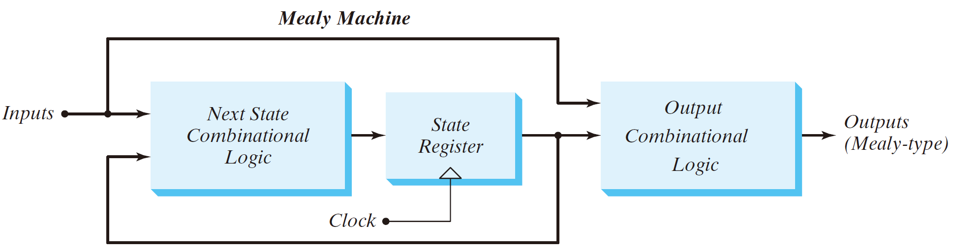
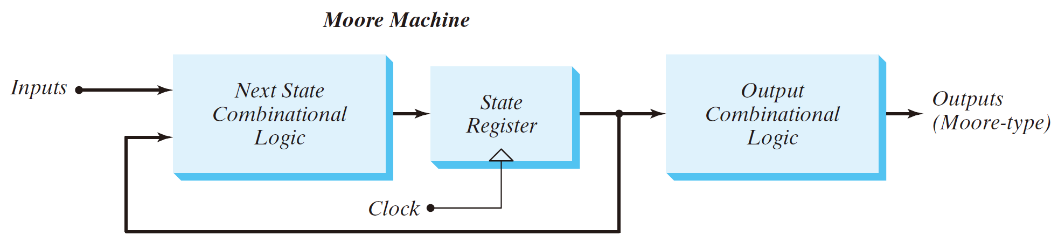

Slide 91
Design Procedure
  the word description of the circuit behavior (a state diagram)
  state reduction if necessary
  assign binary values to the states
  obtain the binary-coded state table
  choose the type of flip-flops
  derive the simplified flip-flop input equations and output equations
  draw the logic diagram

Slide 92
An design example (Synthesis using D flip-flops)
Suppose we wish to design a circuit that detects a sequence of three or more consecutive
1’s in a string of bits coming through an input line.

Slide 93
An design example (Synthesis using D flip-flops)
Suppose we wish to design a circuit that detects a sequence of three or more consecutive
1’s in a string of bits coming through an input line.
000011111000110011110111000
Detector
000000111000000000110001000

Slide 94
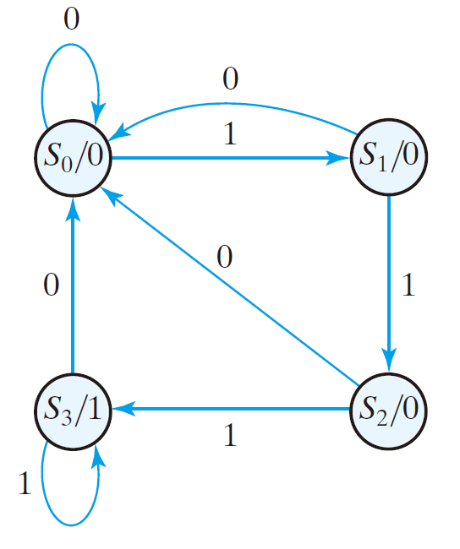
An design example (Synthesis using D flip-flops)
It is derived by starting with state S0, the reset state.
If the input is 0, the circuit stays in S0, but if the input is 1, it goes to state S1 to indicate that a 1 was detected.
If the next input is 1, the change is to state S2 to indicate the arrival of two consecutive 1’s, but if the input is 0, the state goes back to S0.
The third consecutive 1 sends the circuit to state S3. If more 1’s are detected, the circuit stays in S3. Any 0 input sends the circuit back to S0.
The circuit stays in S3 as long as there are three or more consecutive 1’s received.

Slide 95
Present State
A | B

Slide 96
Present State |  | Input
A | B | x

Slide 97
Present State |  | Input
A | B | x
0 | 0 | 0
0 | 0 | 1
0 | 1 | 0
0 | 1 | 1
1 | 0 | 0
1 | 0 | 1
1 | 1 | 0
1 | 1 | 1

Slide 98
Present State |  | Input | Next State |  | Output
A | B | x | A | B | y
0 | 0 | 0
0 | 0 | 1
0 | 1 | 0
0 | 1 | 1
1 | 0 | 0
1 | 0 | 1
1 | 1 | 0
1 | 1 | 1

Slide 99
Present State |  | Input | Next State |  | Output
A | B | x | A | B | y
0 | 0 | 0 |  |  | 0
0 | 0 | 1 |  |  | 0
0 | 1 | 0 |  |  | 0
0 | 1 | 1 |  |  | 0
1 | 0 | 0 |  |  | 0
1 | 0 | 1 |  |  | 0
1 | 1 | 0 |  |  | 1
1 | 1 | 1 |  |  | 1

Slide 100
Present State |  | Input | Next State |  | Output
A | B | x | A | B | y
0 | 0 | 0 | 0 | 0 | 0
0 | 0 | 1 |  |  | 0
0 | 1 | 0 |  |  | 0
0 | 1 | 1 |  |  | 0
1 | 0 | 0 |  |  | 0
1 | 0 | 1 |  |  | 0
1 | 1 | 0 |  |  | 1
1 | 1 | 1 |  |  | 1

Slide 101
Present State |  | Input | Next State |  | Output
A | B | x | A | B | y
0 | 0 | 0 | 0 | 0 | 0
0 | 0 | 1 | 0 | 1 | 0
0 | 1 | 0 |  |  | 0
0 | 1 | 1 |  |  | 0
1 | 0 | 0 |  |  | 0
1 | 0 | 1 |  |  | 0
1 | 1 | 0 |  |  | 1
1 | 1 | 1 |  |  | 1

Slide 102
Present State |  | Input | Next State |  | Output
A | B | x | A | B | y
0 | 0 | 0 | 0 | 0 | 0
0 | 0 | 1 | 0 | 1 | 0
0 | 1 | 0 | 0 | 0 | 0
0 | 1 | 1 |  |  | 0
1 | 0 | 0 |  |  | 0
1 | 0 | 1 |  |  | 0
1 | 1 | 0 |  |  | 1
1 | 1 | 1 |  |  | 1

Slide 103
Present State |  | Input | Next State |  | Output
A | B | x | A | B | y
0 | 0 | 0 | 0 | 0 | 0
0 | 0 | 1 | 0 | 1 | 0
0 | 1 | 0 | 0 | 0 | 0
0 | 1 | 1 | 1 | 0 | 0
1 | 0 | 0 |  |  | 0
1 | 0 | 1 |  |  | 0
1 | 1 | 0 |  |  | 1
1 | 1 | 1 |  |  | 1

Slide 104
Present State |  | Input | Next State |  | Output
A | B | x | A | B | y
0 | 0 | 0 | 0 | 0 | 0
0 | 0 | 1 | 0 | 1 | 0
0 | 1 | 0 | 0 | 0 | 0
0 | 1 | 1 | 1 | 0 | 0
1 | 0 | 0 | 0 | 0 | 0
1 | 0 | 1 |  |  | 0
1 | 1 | 0 |  |  | 1
1 | 1 | 1 |  |  | 1

Slide 105
Present State |  | Input | Next State |  | Output
A | B | x | A | B | y
0 | 0 | 0 | 0 | 0 | 0
0 | 0 | 1 | 0 | 1 | 0
0 | 1 | 0 | 0 | 0 | 0
0 | 1 | 1 | 1 | 0 | 0
1 | 0 | 0 | 0 | 0 | 0
1 | 0 | 1 | 1 | 1 | 0
1 | 1 | 0 |  |  | 1
1 | 1 | 1 |  |  | 1

Slide 106
Present State |  | Input | Next State |  | Output
A | B | x | A | B | y
0 | 0 | 0 | 0 | 0 | 0
0 | 0 | 1 | 0 | 1 | 0
0 | 1 | 0 | 0 | 0 | 0
0 | 1 | 1 | 1 | 0 | 0
1 | 0 | 0 | 0 | 0 | 0
1 | 0 | 1 | 1 | 1 | 0
1 | 1 | 0 | 0 | 0 | 1
1 | 1 | 1 |  |  | 1

Slide 107
Present State |  | Input | Next State |  | Output
A | B | x | A | B | y
0 | 0 | 0 | 0 | 0 | 0
0 | 0 | 1 | 0 | 1 | 0
0 | 1 | 0 | 0 | 0 | 0
0 | 1 | 1 | 1 | 0 | 0
1 | 0 | 0 | 0 | 0 | 0
1 | 0 | 1 | 1 | 1 | 0
1 | 1 | 0 | 0 | 0 | 1
1 | 1 | 1 | 1 | 1 | 1

Slide 108
The flip-flop input equations
Present State |  | Input | Next State |  | Output
A | B | x | A | B | y
0 | 0 | 0 | 0 | 0 | 0
0 | 0 | 1 | 0 | 1 | 0
0 | 1 | 0 | 0 | 0 | 0
0 | 1 | 1 | 1 | 0 | 0
1 | 0 | 0 | 0 | 0 | 0
1 | 0 | 1 | 1 | 1 | 0
1 | 1 | 0 | 0 | 0 | 1
1 | 1 | 1 | 1 | 1 | 1

Slide 109
The flip-flop input equations
Present State |  | Input | Next State |  | Output
A | B | x | A | B | y
0 | 0 | 0 | 0 | 0 | 0
0 | 0 | 1 | 0 | 1 | 0
0 | 1 | 0 | 0 | 0 | 0
0 | 1 | 1 | 1 | 0 | 0
1 | 0 | 0 | 0 | 0 | 0
1 | 0 | 1 | 1 | 1 | 0
1 | 1 | 0 | 0 | 0 | 1
1 | 1 | 1 | 1 | 1 | 1
Flip-Flop Inputs
D_{A} | D_{B}

Slide 110
The flip-flop input equations
Present State |  | Input | Next State |  | Output
A | B | x | A | B | y
0 | 0 | 0 | 0 | 0 | 0
0 | 0 | 1 | 0 | 1 | 0
0 | 1 | 0 | 0 | 0 | 0
0 | 1 | 1 | 1 | 0 | 0
1 | 0 | 0 | 0 | 0 | 0
1 | 0 | 1 | 1 | 1 | 0
1 | 1 | 0 | 0 | 0 | 1
1 | 1 | 1 | 1 | 1 | 1
Flip-Flop Inputs
D_{A} | D_{B}
0
0
0
1
0
1
0
1

Slide 111
The flip-flop input equations
Present State |  | Input | Next State |  | Output
A | B | x | A | B | y
0 | 0 | 0 | 0 | 0 | 0
0 | 0 | 1 | 0 | 1 | 0
0 | 1 | 0 | 0 | 0 | 0
0 | 1 | 1 | 1 | 0 | 0
1 | 0 | 0 | 0 | 0 | 0
1 | 0 | 1 | 1 | 1 | 0
1 | 1 | 0 | 0 | 0 | 1
1 | 1 | 1 | 1 | 1 | 1
Flip-Flop Inputs
D_{A} | D_{B}
0 | 0
0 | 1
0 | 0
1 | 0
0 | 0
1 | 1
0 | 0
1 | 1

Slide 112
The flip-flop input equations
Present State |  | Input | Next State |  | Output
A | B | x | A | B | y
0 | 0 | 0 | 0 | 0 | 0
0 | 0 | 1 | 0 | 1 | 0
0 | 1 | 0 | 0 | 0 | 0
0 | 1 | 1 | 1 | 0 | 0
1 | 0 | 0 | 0 | 0 | 0
1 | 0 | 1 | 1 | 1 | 0
1 | 1 | 0 | 0 | 0 | 1
1 | 1 | 1 | 1 | 1 | 1
Flip-Flop Inputs
D_{A} | D_{B}
0 | 0
0 | 1
0 | 0
1 | 0
0 | 0
1 | 1
0 | 0
1 | 1

Slide 113
The flip-flop input equations
  D_{A}(A, B, x) = Σ(3, 5, 7)
Present State |  | Input | Next State |  | Output
A | B | x | A | B | y
0 | 0 | 0 | 0 | 0 | 0
0 | 0 | 1 | 0 | 1 | 0
0 | 1 | 0 | 0 | 0 | 0
0 | 1 | 1 | 1 | 0 | 0
1 | 0 | 0 | 0 | 0 | 0
1 | 0 | 1 | 1 | 1 | 0
1 | 1 | 0 | 0 | 0 | 1
1 | 1 | 1 | 1 | 1 | 1
Flip-Flop Inputs
D_{A} | D_{B}
0 | 0
0 | 1
0 | 0
1 | 0
0 | 0
1 | 1
0 | 0
1 | 1

Slide 114
The flip-flop input equations
  D_{A}(A, B, x) = Σ(3, 5, 7)
  D_{B}(A ,B, x) = Σ(1, 5, 7)
Present State |  | Input | Next State |  | Output
A | B | x | A | B | y
0 | 0 | 0 | 0 | 0 | 0
0 | 0 | 1 | 0 | 1 | 0
0 | 1 | 0 | 0 | 0 | 0
0 | 1 | 1 | 1 | 0 | 0
1 | 0 | 0 | 0 | 0 | 0
1 | 0 | 1 | 1 | 1 | 0
1 | 1 | 0 | 0 | 0 | 1
1 | 1 | 1 | 1 | 1 | 1
Flip-Flop Inputs
D_{A} | D_{B}
0 | 0
0 | 1
0 | 0
1 | 0
0 | 0
1 | 1
0 | 0
1 | 1

Slide 115
The flip-flop input equations
  D_{A}(A, B, x) = Σ(3, 5, 7)
  D_{B}(A ,B, x) = Σ(1, 5, 7)
Present State |  | Input | Next State |  | Output
A | B | x | A | B | y
0 | 0 | 0 | 0 | 0 | 0
0 | 0 | 1 | 0 | 1 | 0
0 | 1 | 0 | 0 | 0 | 0
0 | 1 | 1 | 1 | 0 | 0
1 | 0 | 0 | 0 | 0 | 0
1 | 0 | 1 | 1 | 1 | 0
1 | 1 | 0 | 0 | 0 | 1
1 | 1 | 1 | 1 | 1 | 1
Flip-Flop Inputs
D_{A} | D_{B}
0 | 0
0 | 1
0 | 0
1 | 0
0 | 0
1 | 1
0 | 0
1 | 1
The output equation

Slide 116
The flip-flop input equations
  D_{A}(A, B, x) = Σ(3, 5, 7)
  D_{B}(A ,B, x) = Σ(1, 5, 7)
Present State |  | Input | Next State |  | Output
A | B | x | A | B | y
0 | 0 | 0 | 0 | 0 | 0
0 | 0 | 1 | 0 | 1 | 0
0 | 1 | 0 | 0 | 0 | 0
0 | 1 | 1 | 1 | 0 | 0
1 | 0 | 0 | 0 | 0 | 0
1 | 0 | 1 | 1 | 1 | 0
1 | 1 | 0 | 0 | 0 | 1
1 | 1 | 1 | 1 | 1 | 1
Flip-Flop Inputs
D_{A} | D_{B}
0 | 0
0 | 1
0 | 0
1 | 0
0 | 0
1 | 1
0 | 0
1 | 1
The output equation

Slide 117
The flip-flop input equations
  D_{A}(A, B, x) = Σ(3, 5, 7)
  D_{B}(A ,B, x) = Σ(1, 5, 7)
Present State |  | Input | Next State |  | Output
A | B | x | A | B | y
0 | 0 | 0 | 0 | 0 | 0
0 | 0 | 1 | 0 | 1 | 0
0 | 1 | 0 | 0 | 0 | 0
0 | 1 | 1 | 1 | 0 | 0
1 | 0 | 0 | 0 | 0 | 0
1 | 0 | 1 | 1 | 1 | 0
1 | 1 | 0 | 0 | 0 | 1
1 | 1 | 1 | 1 | 1 | 1
Flip-Flop Inputs
D_{A} | D_{B}
0 | 0
0 | 1
0 | 0
1 | 0
0 | 0
1 | 1
0 | 0
1 | 1
The output equation
  y(A, B, x) = S(6, 7)

Slide 118
The flip-flop input equations
  D_{A}(A, B, x) = Σ(3, 5, 7)
  D_{B}(A ,B, x) = Σ(1, 5, 7)
The output equation
  y(A, B, x) = Σ(6, 7)

Slide 119
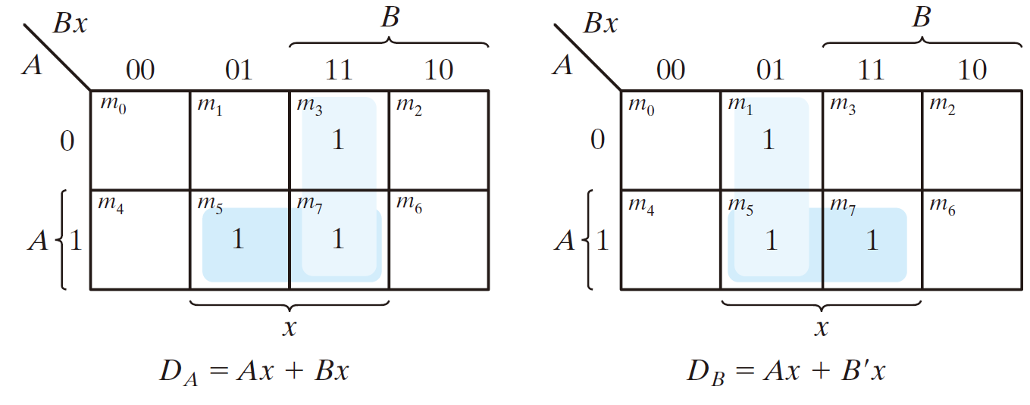
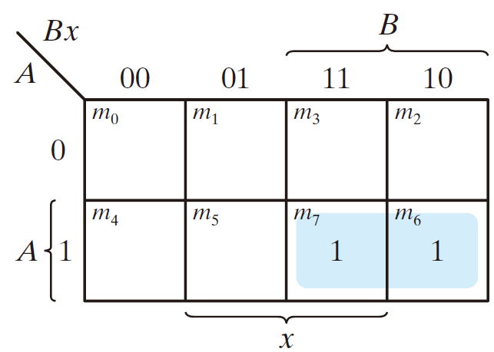
The flip-flop input equations
  D_{A}(A, B, x) = Σ(3, 5, 7)
  D_{B}(A ,B, x) = Σ(1, 5, 7)
The output equation
  y(A, B, x) = Σ(6, 7)

Slide 120
The flip-flop input equations
  D_{A}(A, B, x) = Σ(3, 5, 7) = Ax + Bx
  D_{B}(A ,B, x) = Σ(1, 5, 7) = Ax + B’x
The output equation
  y(A, B, x) = Σ(6, 7) = AB

Slide 121
  D_{A}(A, B, x) = Ax + Bx
  D_{B}(A ,B, x) = Ax + B’x
  y(A, B, x) = AB

Slide 122
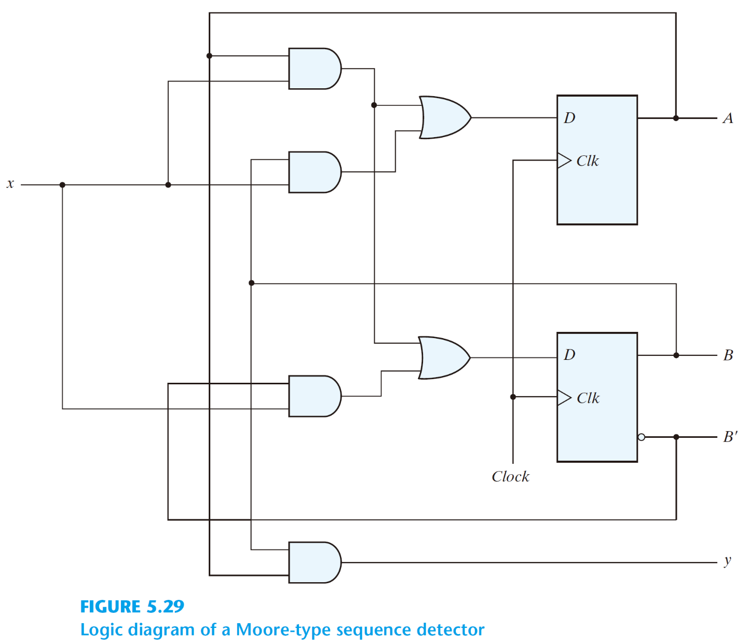
  D_{A}(A, B, x) = Ax + Bx
  D_{B}(A ,B, x) = Ax + B’x
  y(A, B, x) = AB

Slide 123
  D_{A}(A, B, x) = Ax + Bx
  D_{B}(A ,B, x) = Ax + B’x
  y(A, B, x) = AB

Slide 124
  D_{A}(A, B, x) = Ax + Bx
  D_{B}(A ,B, x) = Ax + B’x
  y(A, B, x) = AB

Slide 125
  D_{A}(A, B, x) = Ax + Bx
  D_{B}(A ,B, x) = Ax + B’x
  y(A, B, x) = AB

Slide 126
  D_{A}(A, B, x) = Ax + Bx
  D_{B}(A ,B, x) = Ax + B’x
  y(A, B, x) = AB

Slide 127
An design example (Synthesis using J-K flip-flops)

Slide 128
An design example (Synthesis using J-K flip-flops)
Present State |  | Input | Next State |  | Output
A | B | x | A | B | y
0 | 0 | 0 | 0 | 0 | 0
0 | 0 | 1 | 0 | 1 | 0
0 | 1 | 0 | 0 | 0 | 0
0 | 1 | 1 | 1 | 0 | 0
1 | 0 | 0 | 0 | 0 | 0
1 | 0 | 1 | 1 | 1 | 0
1 | 1 | 0 | 0 | 0 | 1
1 | 1 | 1 | 1 | 1 | 1

Slide 129
An design example (Synthesis using J-K flip-flops)
Present State |  | Input | Next State |  | Output
A | B | x | A | B | y
0 | 0 | 0 | 0 | 0 | 0
0 | 0 | 1 | 0 | 1 | 0
0 | 1 | 0 | 0 | 0 | 0
0 | 1 | 1 | 1 | 0 | 0
1 | 0 | 0 | 0 | 0 | 0
1 | 0 | 1 | 1 | 1 | 0
1 | 1 | 0 | 0 | 0 | 1
1 | 1 | 1 | 1 | 1 | 1
Flip-Flop Inputs
J_{A} | K_{A} | J_{B} | K_{B}

Slide 130
An design example (Synthesis using J-K flip-flops)
Present State |  | Input | Next State |  | Output
A | B | x | A | B | y
0 | 0 | 0 | 0 | 0 | 0
0 | 0 | 1 | 0 | 1 | 0
0 | 1 | 0 | 0 | 0 | 0
0 | 1 | 1 | 1 | 0 | 0
1 | 0 | 0 | 0 | 0 | 0
1 | 0 | 1 | 1 | 1 | 0
1 | 1 | 0 | 0 | 0 | 1
1 | 1 | 1 | 1 | 1 | 1
Flip-Flop Inputs
J_{A} | K_{A} | J_{B} | K_{B}

Slide 131
An design example (Synthesis using J-K flip-flops)
Present State |  | Input | Next State |  | Output
A | B | x | A | B | y
0 | 0 | 0 | 0 | 0 | 0
0 | 0 | 1 | 0 | 1 | 0
0 | 1 | 0 | 0 | 0 | 0
0 | 1 | 1 | 1 | 0 | 0
1 | 0 | 0 | 0 | 0 | 0
1 | 0 | 1 | 1 | 1 | 0
1 | 1 | 0 | 0 | 0 | 1
1 | 1 | 1 | 1 | 1 | 1
Flip-Flop Inputs
J_{A} | K_{A} | J_{B} | K_{B}
0 | 0

Slide 132
An design example (Synthesis using J-K flip-flops)
Present State |  | Input | Next State |  | Output
A | B | x | A | B | y
0 | 0 | 0 | 0 | 0 | 0
0 | 0 | 1 | 0 | 1 | 0
0 | 1 | 0 | 0 | 0 | 0
0 | 1 | 1 | 1 | 0 | 0
1 | 0 | 0 | 0 | 0 | 0
1 | 0 | 1 | 1 | 1 | 0
1 | 1 | 0 | 0 | 0 | 1
1 | 1 | 1 | 1 | 1 | 1
Flip-Flop Inputs
J_{A} | K_{A} | J_{B} | K_{B}
0 | 1

Slide 133
An design example (Synthesis using J-K flip-flops)
Present State |  | Input | Next State |  | Output
A | B | x | A | B | y
0 | 0 | 0 | 0 | 0 | 0
0 | 0 | 1 | 0 | 1 | 0
0 | 1 | 0 | 0 | 0 | 0
0 | 1 | 1 | 1 | 0 | 0
1 | 0 | 0 | 0 | 0 | 0
1 | 0 | 1 | 1 | 1 | 0
1 | 1 | 0 | 0 | 0 | 1
1 | 1 | 1 | 1 | 1 | 1
Flip-Flop Inputs
J_{A} | K_{A} | J_{B} | K_{B}
0/0 | 0/1

Slide 134
An design example (Synthesis using J-K flip-flops)
Present State |  | Input | Next State |  | Output
A | B | x | A | B | y
0 | 0 | 0 | 0 | 0 | 0
0 | 0 | 1 | 0 | 1 | 0
0 | 1 | 0 | 0 | 0 | 0
0 | 1 | 1 | 1 | 0 | 0
1 | 0 | 0 | 0 | 0 | 0
1 | 0 | 1 | 1 | 1 | 0
1 | 1 | 0 | 0 | 0 | 1
1 | 1 | 1 | 1 | 1 | 1
Flip-Flop Inputs
J_{A} | K_{A} | J_{B} | K_{B}
0 | x

Slide 135
An design example (Synthesis using J-K flip-flops)
Present State |  | Input | Next State |  | Output
A | B | x | A | B | y
0 | 0 | 0 | 0 | 0 | 0
0 | 0 | 1 | 0 | 1 | 0
0 | 1 | 0 | 0 | 0 | 0
0 | 1 | 1 | 1 | 0 | 0
1 | 0 | 0 | 0 | 0 | 0
1 | 0 | 1 | 1 | 1 | 0
1 | 1 | 0 | 0 | 0 | 1
1 | 1 | 1 | 1 | 1 | 1
Flip-Flop Inputs
J_{A} | K_{A} | J_{B} | K_{B}
0 | x

Slide 136
An design example (Synthesis using J-K flip-flops)
Present State |  | Input | Next State |  | Output
A | B | x | A | B | y
0 | 0 | 0 | 0 | 0 | 0
0 | 0 | 1 | 0 | 1 | 0
0 | 1 | 0 | 0 | 0 | 0
0 | 1 | 1 | 1 | 0 | 0
1 | 0 | 0 | 0 | 0 | 0
1 | 0 | 1 | 1 | 1 | 0
1 | 1 | 0 | 0 | 0 | 1
1 | 1 | 1 | 1 | 1 | 1
Flip-Flop Inputs
J_{A} | K_{A} | J_{B} | K_{B}
0 | x

Slide 137
An design example (Synthesis using J-K flip-flops)
Present State |  | Input | Next State |  | Output
A | B | x | A | B | y
0 | 0 | 0 | 0 | 0 | 0
0 | 0 | 1 | 0 | 1 | 0
0 | 1 | 0 | 0 | 0 | 0
0 | 1 | 1 | 1 | 0 | 0
1 | 0 | 0 | 0 | 0 | 0
1 | 0 | 1 | 1 | 1 | 0
1 | 1 | 0 | 0 | 0 | 1
1 | 1 | 1 | 1 | 1 | 1
Flip-Flop Inputs
J_{A} | K_{A} | J_{B} | K_{B}
0 | x
0 | x

Slide 138
An design example (Synthesis using J-K flip-flops)
Present State |  | Input | Next State |  | Output
A | B | x | A | B | y
0 | 0 | 0 | 0 | 0 | 0
0 | 0 | 1 | 0 | 1 | 0
0 | 1 | 0 | 0 | 0 | 0
0 | 1 | 1 | 1 | 0 | 0
1 | 0 | 0 | 0 | 0 | 0
1 | 0 | 1 | 1 | 1 | 0
1 | 1 | 0 | 0 | 0 | 1
1 | 1 | 1 | 1 | 1 | 1
Flip-Flop Inputs
J_{A} | K_{A} | J_{B} | K_{B}
0 | x
0 | x

Slide 139
An design example (Synthesis using J-K flip-flops)
Present State |  | Input | Next State |  | Output
A | B | x | A | B | y
0 | 0 | 0 | 0 | 0 | 0
0 | 0 | 1 | 0 | 1 | 0
0 | 1 | 0 | 0 | 0 | 0
0 | 1 | 1 | 1 | 0 | 0
1 | 0 | 0 | 0 | 0 | 0
1 | 0 | 1 | 1 | 1 | 0
1 | 1 | 0 | 0 | 0 | 1
1 | 1 | 1 | 1 | 1 | 1
Flip-Flop Inputs
J_{A} | K_{A} | J_{B} | K_{B}
0 | x
0 | x
0 | x

Slide 140
An design example (Synthesis using J-K flip-flops)
Present State |  | Input | Next State |  | Output
A | B | x | A | B | y
0 | 0 | 0 | 0 | 0 | 0
0 | 0 | 1 | 0 | 1 | 0
0 | 1 | 0 | 0 | 0 | 0
0 | 1 | 1 | 1 | 0 | 0
1 | 0 | 0 | 0 | 0 | 0
1 | 0 | 1 | 1 | 1 | 0
1 | 1 | 0 | 0 | 0 | 1
1 | 1 | 1 | 1 | 1 | 1
Flip-Flop Inputs
J_{A} | K_{A} | J_{B} | K_{B}
0 | x
0 | x
0 | x

Slide 141
An design example (Synthesis using J-K flip-flops)
Present State |  | Input | Next State |  | Output
A | B | x | A | B | y
0 | 0 | 0 | 0 | 0 | 0
0 | 0 | 1 | 0 | 1 | 0
0 | 1 | 0 | 0 | 0 | 0
0 | 1 | 1 | 1 | 0 | 0
1 | 0 | 0 | 0 | 0 | 0
1 | 0 | 1 | 1 | 1 | 0
1 | 1 | 0 | 0 | 0 | 1
1 | 1 | 1 | 1 | 1 | 1
Flip-Flop Inputs
J_{A} | K_{A} | J_{B} | K_{B}
0 | x
0 | x
0 | x
1 | 1

Slide 142
An design example (Synthesis using J-K flip-flops)
Present State |  | Input | Next State |  | Output
A | B | x | A | B | y
0 | 0 | 0 | 0 | 0 | 0
0 | 0 | 1 | 0 | 1 | 0
0 | 1 | 0 | 0 | 0 | 0
0 | 1 | 1 | 1 | 0 | 0
1 | 0 | 0 | 0 | 0 | 0
1 | 0 | 1 | 1 | 1 | 0
1 | 1 | 0 | 0 | 0 | 1
1 | 1 | 1 | 1 | 1 | 1
Flip-Flop Inputs
J_{A} | K_{A} | J_{B} | K_{B}
0 | x
0 | x
0 | x
1 | 0

Slide 143
An design example (Synthesis using J-K flip-flops)
Present State |  | Input | Next State |  | Output
A | B | x | A | B | y
0 | 0 | 0 | 0 | 0 | 0
0 | 0 | 1 | 0 | 1 | 0
0 | 1 | 0 | 0 | 0 | 0
0 | 1 | 1 | 1 | 0 | 0
1 | 0 | 0 | 0 | 0 | 0
1 | 0 | 1 | 1 | 1 | 0
1 | 1 | 0 | 0 | 0 | 1
1 | 1 | 1 | 1 | 1 | 1
Flip-Flop Inputs
J_{A} | K_{A} | J_{B} | K_{B}
0 | x
0 | x
0 | x
1/1 | 1/0

Slide 144
An design example (Synthesis using J-K flip-flops)
Present State |  | Input | Next State |  | Output
A | B | x | A | B | y
0 | 0 | 0 | 0 | 0 | 0
0 | 0 | 1 | 0 | 1 | 0
0 | 1 | 0 | 0 | 0 | 0
0 | 1 | 1 | 1 | 0 | 0
1 | 0 | 0 | 0 | 0 | 0
1 | 0 | 1 | 1 | 1 | 0
1 | 1 | 0 | 0 | 0 | 1
1 | 1 | 1 | 1 | 1 | 1
Flip-Flop Inputs
J_{A} | K_{A} | J_{B} | K_{B}
0 | x
0 | x
0 | x
1 | x

Slide 145
An design example (Synthesis using J-K flip-flops)
Present State |  | Input | Next State |  | Output
A | B | x | A | B | y
0 | 0 | 0 | 0 | 0 | 0
0 | 0 | 1 | 0 | 1 | 0
0 | 1 | 0 | 0 | 0 | 0
0 | 1 | 1 | 1 | 0 | 0
1 | 0 | 0 | 0 | 0 | 0
1 | 0 | 1 | 1 | 1 | 0
1 | 1 | 0 | 0 | 0 | 1
1 | 1 | 1 | 1 | 1 | 1
Flip-Flop Inputs
J_{A} | K_{A} | J_{B} | K_{B}
0 | x
0 | x
0 | x
1 | x

Slide 146
An design example (Synthesis using J-K flip-flops)
Present State |  | Input | Next State |  | Output
A | B | x | A | B | y
0 | 0 | 0 | 0 | 0 | 0
0 | 0 | 1 | 0 | 1 | 0
0 | 1 | 0 | 0 | 0 | 0
0 | 1 | 1 | 1 | 0 | 0
1 | 0 | 0 | 0 | 0 | 0
1 | 0 | 1 | 1 | 1 | 0
1 | 1 | 0 | 0 | 0 | 1
1 | 1 | 1 | 1 | 1 | 1
Flip-Flop Inputs
J_{A} | K_{A} | J_{B} | K_{B}
0 | x
0 | x
0 | x
1 | x
1 | 1

Slide 147
An design example (Synthesis using J-K flip-flops)
Present State |  | Input | Next State |  | Output
A | B | x | A | B | y
0 | 0 | 0 | 0 | 0 | 0
0 | 0 | 1 | 0 | 1 | 0
0 | 1 | 0 | 0 | 0 | 0
0 | 1 | 1 | 1 | 0 | 0
1 | 0 | 0 | 0 | 0 | 0
1 | 0 | 1 | 1 | 1 | 0
1 | 1 | 0 | 0 | 0 | 1
1 | 1 | 1 | 1 | 1 | 1
Flip-Flop Inputs
J_{A} | K_{A} | J_{B} | K_{B}
0 | x
0 | x
0 | x
1 | x
0 | 1

Slide 148
An design example (Synthesis using J-K flip-flops)
Present State |  | Input | Next State |  | Output
A | B | x | A | B | y
0 | 0 | 0 | 0 | 0 | 0
0 | 0 | 1 | 0 | 1 | 0
0 | 1 | 0 | 0 | 0 | 0
0 | 1 | 1 | 1 | 0 | 0
1 | 0 | 0 | 0 | 0 | 0
1 | 0 | 1 | 1 | 1 | 0
1 | 1 | 0 | 0 | 0 | 1
1 | 1 | 1 | 1 | 1 | 1
Flip-Flop Inputs
J_{A} | K_{A} | J_{B} | K_{B}
0 | x
0 | x
0 | x
1 | x
1/0 | 1/1

Slide 149
An design example (Synthesis using J-K flip-flops)
Present State |  | Input | Next State |  | Output
A | B | x | A | B | y
0 | 0 | 0 | 0 | 0 | 0
0 | 0 | 1 | 0 | 1 | 0
0 | 1 | 0 | 0 | 0 | 0
0 | 1 | 1 | 1 | 0 | 0
1 | 0 | 0 | 0 | 0 | 0
1 | 0 | 1 | 1 | 1 | 0
1 | 1 | 0 | 0 | 0 | 1
1 | 1 | 1 | 1 | 1 | 1
Flip-Flop Inputs
J_{A} | K_{A} | J_{B} | K_{B}
0 | x
0 | x
0 | x
1 | x
1/0 | 1/1

Slide 150
An design example (Synthesis using J-K flip-flops)
Present State |  | Input | Next State |  | Output
A | B | x | A | B | y
0 | 0 | 0 | 0 | 0 | 0
0 | 0 | 1 | 0 | 1 | 0
0 | 1 | 0 | 0 | 0 | 0
0 | 1 | 1 | 1 | 0 | 0
1 | 0 | 0 | 0 | 0 | 0
1 | 0 | 1 | 1 | 1 | 0
1 | 1 | 0 | 0 | 0 | 1
1 | 1 | 1 | 1 | 1 | 1
Flip-Flop Inputs
J_{A} | K_{A} | J_{B} | K_{B}
0 | x
0 | x
0 | x
1 | x
x | 1

Slide 151
An design example (Synthesis using J-K flip-flops)
Present State |  | Input | Next State |  | Output
A | B | x | A | B | y
0 | 0 | 0 | 0 | 0 | 0
0 | 0 | 1 | 0 | 1 | 0
0 | 1 | 0 | 0 | 0 | 0
0 | 1 | 1 | 1 | 0 | 0
1 | 0 | 0 | 0 | 0 | 0
1 | 0 | 1 | 1 | 1 | 0
1 | 1 | 0 | 0 | 0 | 1
1 | 1 | 1 | 1 | 1 | 1
Flip-Flop Inputs
J_{A} | K_{A} | J_{B} | K_{B}
0 | x
0 | x
0 | x
1 | x
x | 1
0 | 0

Slide 152
An design example (Synthesis using J-K flip-flops)
Present State |  | Input | Next State |  | Output
A | B | x | A | B | y
0 | 0 | 0 | 0 | 0 | 0
0 | 0 | 1 | 0 | 1 | 0
0 | 1 | 0 | 0 | 0 | 0
0 | 1 | 1 | 1 | 0 | 0
1 | 0 | 0 | 0 | 0 | 0
1 | 0 | 1 | 1 | 1 | 0
1 | 1 | 0 | 0 | 0 | 1
1 | 1 | 1 | 1 | 1 | 1
Flip-Flop Inputs
J_{A} | K_{A} | J_{B} | K_{B}
0 | x
0 | x
0 | x
1 | x
x | 1
1 | 0

Slide 153
An design example (Synthesis using J-K flip-flops)
Present State |  | Input | Next State |  | Output
A | B | x | A | B | y
0 | 0 | 0 | 0 | 0 | 0
0 | 0 | 1 | 0 | 1 | 0
0 | 1 | 0 | 0 | 0 | 0
0 | 1 | 1 | 1 | 0 | 0
1 | 0 | 0 | 0 | 0 | 0
1 | 0 | 1 | 1 | 1 | 0
1 | 1 | 0 | 0 | 0 | 1
1 | 1 | 1 | 1 | 1 | 1
Flip-Flop Inputs
J_{A} | K_{A} | J_{B} | K_{B}
0 | x
0 | x
0 | x
1 | x
x | 1
0/1 | 0/0

Slide 154
An design example (Synthesis using J-K flip-flops)
Present State |  | Input | Next State |  | Output
A | B | x | A | B | y
0 | 0 | 0 | 0 | 0 | 0
0 | 0 | 1 | 0 | 1 | 0
0 | 1 | 0 | 0 | 0 | 0
0 | 1 | 1 | 1 | 0 | 0
1 | 0 | 0 | 0 | 0 | 0
1 | 0 | 1 | 1 | 1 | 0
1 | 1 | 0 | 0 | 0 | 1
1 | 1 | 1 | 1 | 1 | 1
Flip-Flop Inputs
J_{A} | K_{A} | J_{B} | K_{B}
0 | x
0 | x
0 | x
1 | x
x | 1
x | 0

Slide 155
An design example (Synthesis using J-K flip-flops)
Present State |  | Input | Next State |  | Output
A | B | x | A | B | y
0 | 0 | 0 | 0 | 0 | 0
0 | 0 | 1 | 0 | 1 | 0
0 | 1 | 0 | 0 | 0 | 0
0 | 1 | 1 | 1 | 0 | 0
1 | 0 | 0 | 0 | 0 | 0
1 | 0 | 1 | 1 | 1 | 0
1 | 1 | 0 | 0 | 0 | 1
1 | 1 | 1 | 1 | 1 | 1
Flip-Flop Inputs
J_{A} | K_{A} | J_{B} | K_{B}
0 | x
0 | x
0 | x
1 | x
x | 1
x | 0

Slide 156
An design example (Synthesis using J-K flip-flops)
Present State |  | Input | Next State |  | Output
A | B | x | A | B | y
0 | 0 | 0 | 0 | 0 | 0
0 | 0 | 1 | 0 | 1 | 0
0 | 1 | 0 | 0 | 0 | 0
0 | 1 | 1 | 1 | 0 | 0
1 | 0 | 0 | 0 | 0 | 0
1 | 0 | 1 | 1 | 1 | 0
1 | 1 | 0 | 0 | 0 | 1
1 | 1 | 1 | 1 | 1 | 1
Flip-Flop Inputs
J_{A} | K_{A} | J_{B} | K_{B}
0 | x
0 | x
0 | x
1 | x
x | 1
x | 0
x | 1

Slide 157
An design example (Synthesis using J-K flip-flops)
Present State |  | Input | Next State |  | Output
A | B | x | A | B | y
0 | 0 | 0 | 0 | 0 | 0
0 | 0 | 1 | 0 | 1 | 0
0 | 1 | 0 | 0 | 0 | 0
0 | 1 | 1 | 1 | 0 | 0
1 | 0 | 0 | 0 | 0 | 0
1 | 0 | 1 | 1 | 1 | 0
1 | 1 | 0 | 0 | 0 | 1
1 | 1 | 1 | 1 | 1 | 1
Flip-Flop Inputs
J_{A} | K_{A} | J_{B} | K_{B}
0 | x
0 | x
0 | x
1 | x
x | 1
x | 0
x | 1

Slide 158
An design example (Synthesis using J-K flip-flops)
Present State |  | Input | Next State |  | Output
A | B | x | A | B | y
0 | 0 | 0 | 0 | 0 | 0
0 | 0 | 1 | 0 | 1 | 0
0 | 1 | 0 | 0 | 0 | 0
0 | 1 | 1 | 1 | 0 | 0
1 | 0 | 0 | 0 | 0 | 0
1 | 0 | 1 | 1 | 1 | 0
1 | 1 | 0 | 0 | 0 | 1
1 | 1 | 1 | 1 | 1 | 1
Flip-Flop Inputs
J_{A} | K_{A} | J_{B} | K_{B}
0 | x
0 | x
0 | x
1 | x
x | 1
x | 0
x | 1
x | 0

Slide 159
An design example (Synthesis using J-K flip-flops)
Present State |  | Input | Next State |  | Output
A | B | x | A | B | y
0 | 0 | 0 | 0 | 0 | 0
0 | 0 | 1 | 0 | 1 | 0
0 | 1 | 0 | 0 | 0 | 0
0 | 1 | 1 | 1 | 0 | 0
1 | 0 | 0 | 0 | 0 | 0
1 | 0 | 1 | 1 | 1 | 0
1 | 1 | 0 | 0 | 0 | 1
1 | 1 | 1 | 1 | 1 | 1
Flip-Flop Inputs
J_{A} | K_{A} | J_{B} | K_{B}
0 | x
0 | x
0 | x
1 | x
x | 1
x | 0
x | 1
x | 0

Slide 160
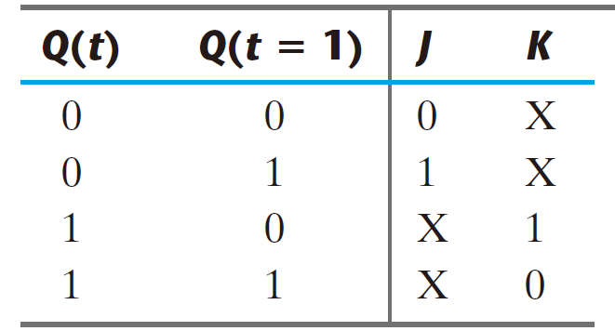
Excitation table
Present State |  | Input | Next State |  | Output
A | B | x | A | B | y
0 | 0 | 0 | 0 | 0 | 0
0 | 0 | 1 | 0 | 1 | 0
0 | 1 | 0 | 0 | 0 | 0
0 | 1 | 1 | 1 | 0 | 0
1 | 0 | 0 | 0 | 0 | 0
1 | 0 | 1 | 1 | 1 | 0
1 | 1 | 0 | 0 | 0 | 1
1 | 1 | 1 | 1 | 1 | 1
Flip-Flop Inputs
J_{A} | K_{A} | J_{B} | K_{B}
0 | x
0 | x
0 | x
1 | x
x | 1
x | 0
x | 1
x | 0

Slide 161
Excitation table
Present State |  | Input | Next State |  | Output
A | B | x | A | B | y
0 | 0 | 0 | 0 | 0 | 0
0 | 0 | 1 | 0 | 1 | 0
0 | 1 | 0 | 0 | 0 | 0
0 | 1 | 1 | 1 | 0 | 0
1 | 0 | 0 | 0 | 0 | 0
1 | 0 | 1 | 1 | 1 | 0
1 | 1 | 0 | 0 | 0 | 1
1 | 1 | 1 | 1 | 1 | 1
Flip-Flop Inputs
J_{A} | K_{A} | J_{B} | K_{B}
0 | x
0 | x
0 | x
1 | x
x | 1
x | 0
x | 1
x | 0

Slide 162
Excitation table
Present State |  | Input | Next State |  | Output
A | B | x | A | B | y
0 | 0 | 0 | 0 | 0 | 0
0 | 0 | 1 | 0 | 1 | 0
0 | 1 | 0 | 0 | 0 | 0
0 | 1 | 1 | 1 | 0 | 0
1 | 0 | 0 | 0 | 0 | 0
1 | 0 | 1 | 1 | 1 | 0
1 | 1 | 0 | 0 | 0 | 1
1 | 1 | 1 | 1 | 1 | 1
Flip-Flop Inputs
J_{A} | K_{A} | J_{B} | K_{B}
0 | x
0 | x
0 | x
1 | x
x | 1
x | 0
x | 1
x | 0

Slide 163
Excitation table
Present State |  | Input | Next State |  | Output
A | B | x | A | B | y
0 | 0 | 0 | 0 | 0 | 0
0 | 0 | 1 | 0 | 1 | 0
0 | 1 | 0 | 0 | 0 | 0
0 | 1 | 1 | 1 | 0 | 0
1 | 0 | 0 | 0 | 0 | 0
1 | 0 | 1 | 1 | 1 | 0
1 | 1 | 0 | 0 | 0 | 1
1 | 1 | 1 | 1 | 1 | 1
Flip-Flop Inputs
J_{A} | K_{A} | J_{B} | K_{B}
0 | x
0 | x
0 | x
1 | x
x | 1
x | 0
x | 1
x | 0

Slide 164
Excitation table
Present State |  | Input | Next State |  | Output
A | B | x | A | B | y
0 | 0 | 0 | 0 | 0 | 0
0 | 0 | 1 | 0 | 1 | 0
0 | 1 | 0 | 0 | 0 | 0
0 | 1 | 1 | 1 | 0 | 0
1 | 0 | 0 | 0 | 0 | 0
1 | 0 | 1 | 1 | 1 | 0
1 | 1 | 0 | 0 | 0 | 1
1 | 1 | 1 | 1 | 1 | 1
Flip-Flop Inputs
J_{A} | K_{A} | J_{B} | K_{B}
0 | x
0 | x
0 | x
1 | x
x | 1
x | 0
x | 1
x | 0

Slide 165
Excitation table
Present State |  | Input | Next State |  | Output
A | B | x | A | B | y
0 | 0 | 0 | 0 | 0 | 0
0 | 0 | 1 | 0 | 1 | 0
0 | 1 | 0 | 0 | 0 | 0
0 | 1 | 1 | 1 | 0 | 0
1 | 0 | 0 | 0 | 0 | 0
1 | 0 | 1 | 1 | 1 | 0
1 | 1 | 0 | 0 | 0 | 1
1 | 1 | 1 | 1 | 1 | 1
Flip-Flop Inputs
J_{A} | K_{A} | J_{B} | K_{B}
0 | x
0 | x
0 | x
1 | x
x | 1
x | 0
x | 1
x | 0

Slide 166
Excitation table
Present State |  | Input | Next State |  | Output
A | B | x | A | B | y
0 | 0 | 0 | 0 | 0 | 0
0 | 0 | 1 | 0 | 1 | 0
0 | 1 | 0 | 0 | 0 | 0
0 | 1 | 1 | 1 | 0 | 0
1 | 0 | 0 | 0 | 0 | 0
1 | 0 | 1 | 1 | 1 | 0
1 | 1 | 0 | 0 | 0 | 1
1 | 1 | 1 | 1 | 1 | 1
Flip-Flop Inputs
J_{A} | K_{A} | J_{B} | K_{B}
0 | x
0 | x
0 | x
1 | x
x | 1
x | 0
x | 1
x | 0

Slide 167
Excitation table
Present State |  | Input | Next State |  | Output
A | B | x | A | B | y
0 | 0 | 0 | 0 | 0 | 0
0 | 0 | 1 | 0 | 1 | 0
0 | 1 | 0 | 0 | 0 | 0
0 | 1 | 1 | 1 | 0 | 0
1 | 0 | 0 | 0 | 0 | 0
1 | 0 | 1 | 1 | 1 | 0
1 | 1 | 0 | 0 | 0 | 1
1 | 1 | 1 | 1 | 1 | 1
Flip-Flop Inputs
J_{A} | K_{A} | J_{B} | K_{B}
0 | x
0 | x
0 | x
1 | x
x | 1
x | 0
x | 1
x | 0

Slide 168
Excitation table
Present State |  | Input | Next State |  | Output
A | B | x | A | B | y
0 | 0 | 0 | 0 | 0 | 0
0 | 0 | 1 | 0 | 1 | 0
0 | 1 | 0 | 0 | 0 | 0
0 | 1 | 1 | 1 | 0 | 0
1 | 0 | 0 | 0 | 0 | 0
1 | 0 | 1 | 1 | 1 | 0
1 | 1 | 0 | 0 | 0 | 1
1 | 1 | 1 | 1 | 1 | 1
Flip-Flop Inputs
J_{A} | K_{A} | J_{B} | K_{B}
0 | x | 0 | x
0 | x
0 | x
1 | x
x | 1 | 0 | x
x | 0
x | 1
x | 0

Slide 169
Excitation table
Present State |  | Input | Next State |  | Output
A | B | x | A | B | y
0 | 0 | 0 | 0 | 0 | 0
0 | 0 | 1 | 0 | 1 | 0
0 | 1 | 0 | 0 | 0 | 0
0 | 1 | 1 | 1 | 0 | 0
1 | 0 | 0 | 0 | 0 | 0
1 | 0 | 1 | 1 | 1 | 0
1 | 1 | 0 | 0 | 0 | 1
1 | 1 | 1 | 1 | 1 | 1
Flip-Flop Inputs
J_{A} | K_{A} | J_{B} | K_{B}
0 | x | 0 | x
0 | x
0 | x
1 | x
x | 1 | 0 | x
x | 0
x | 1
x | 0

Slide 170
Excitation table
Present State |  | Input | Next State |  | Output
A | B | x | A | B | y
0 | 0 | 0 | 0 | 0 | 0
0 | 0 | 1 | 0 | 1 | 0
0 | 1 | 0 | 0 | 0 | 0
0 | 1 | 1 | 1 | 0 | 0
1 | 0 | 0 | 0 | 0 | 0
1 | 0 | 1 | 1 | 1 | 0
1 | 1 | 0 | 0 | 0 | 1
1 | 1 | 1 | 1 | 1 | 1
Flip-Flop Inputs
J_{A} | K_{A} | J_{B} | K_{B}
0 | x | 0 | x
0 | x | 1 | x
0 | x
1 | x
x | 1 | 0 | x
x | 0 | 1 | x
x | 1
x | 0

Slide 171
Excitation table
Present State |  | Input | Next State |  | Output
A | B | x | A | B | y
0 | 0 | 0 | 0 | 0 | 0
0 | 0 | 1 | 0 | 1 | 0
0 | 1 | 0 | 0 | 0 | 0
0 | 1 | 1 | 1 | 0 | 0
1 | 0 | 0 | 0 | 0 | 0
1 | 0 | 1 | 1 | 1 | 0
1 | 1 | 0 | 0 | 0 | 1
1 | 1 | 1 | 1 | 1 | 1
Flip-Flop Inputs
J_{A} | K_{A} | J_{B} | K_{B}
0 | x | 0 | x
0 | x | 1 | x
0 | x
1 | x
x | 1 | 0 | x
x | 0 | 1 | x
x | 1
x | 0

Slide 172
Excitation table
Present State |  | Input | Next State |  | Output
A | B | x | A | B | y
0 | 0 | 0 | 0 | 0 | 0
0 | 0 | 1 | 0 | 1 | 0
0 | 1 | 0 | 0 | 0 | 0
0 | 1 | 1 | 1 | 0 | 0
1 | 0 | 0 | 0 | 0 | 0
1 | 0 | 1 | 1 | 1 | 0
1 | 1 | 0 | 0 | 0 | 1
1 | 1 | 1 | 1 | 1 | 1
Flip-Flop Inputs
J_{A} | K_{A} | J_{B} | K_{B}
0 | x | 0 | x
0 | x | 1 | x
0 | x | x | 1
1 | x | x | 1
x | 1 | 0 | x
x | 0 | 1 | x
x | 1 | x | 1
x | 0

Slide 173
Excitation table
Present State |  | Input | Next State |  | Output
A | B | x | A | B | y
0 | 0 | 0 | 0 | 0 | 0
0 | 0 | 1 | 0 | 1 | 0
0 | 1 | 0 | 0 | 0 | 0
0 | 1 | 1 | 1 | 0 | 0
1 | 0 | 0 | 0 | 0 | 0
1 | 0 | 1 | 1 | 1 | 0
1 | 1 | 0 | 0 | 0 | 1
1 | 1 | 1 | 1 | 1 | 1
Flip-Flop Inputs
J_{A} | K_{A} | J_{B} | K_{B}
0 | x | 0 | x
0 | x | 1 | x
0 | x | x | 1
1 | x | x | 1
x | 1 | 0 | x
x | 0 | 1 | x
x | 1 | x | 1
x | 0

Slide 174
Excitation table
Present State |  | Input | Next State |  | Output
A | B | x | A | B | y
0 | 0 | 0 | 0 | 0 | 0
0 | 0 | 1 | 0 | 1 | 0
0 | 1 | 0 | 0 | 0 | 0
0 | 1 | 1 | 1 | 0 | 0
1 | 0 | 0 | 0 | 0 | 0
1 | 0 | 1 | 1 | 1 | 0
1 | 1 | 0 | 0 | 0 | 1
1 | 1 | 1 | 1 | 1 | 1
Flip-Flop Inputs
J_{A} | K_{A} | J_{B} | K_{B}
0 | x | 0 | x
0 | x | 1 | x
0 | x | x | 1
1 | x | x | 1
x | 1 | 0 | x
x | 0 | 1 | x
x | 1 | x | 1
x | 0 | x | 0

Slide 175
The flip-flop input equations
  J_{A} = Σ(3) + D(4, 5, 6, 7)
  K_{A} = Σ(4, 6) + D(0, 1, 2, 3)
  J_{B} = Σ(1, 5) + D(2, 3, 6, 7)
  K_{B} = Σ(2, 3, 6) + D(0, 1, 4, 5)
Present State |  | Input | Next State |  | Output
A | B | x | A | B | y
0 | 0 | 0 | 0 | 0 | 0
0 | 0 | 1 | 0 | 1 | 0
0 | 1 | 0 | 0 | 0 | 0
0 | 1 | 1 | 1 | 0 | 0
1 | 0 | 0 | 0 | 0 | 0
1 | 0 | 1 | 1 | 1 | 0
1 | 1 | 0 | 0 | 0 | 1
1 | 1 | 1 | 1 | 1 | 1
Flip-Flop Inputs
J_{A} | K_{A} | J_{B} | K_{B}
0 | x | 0 | x
0 | x | 1 | x
0 | x | x | 1
1 | x | x | 1
x | 1 | 0 | x
x | 0 | 1 | x
x | 1 | x | 1
x | 0 | x | 0
The output equation
  y = Σ(6, 7) = AB

Slide 176
The flip-flop input equations
  J_{A} = Σ(3) + D(4, 5, 6, 7)
  K_{A} = Σ(4, 6) + D(0, 1, 2, 3)
  J_{B} = Σ(1, 5) + D(2, 3, 6, 7)
  K_{B} = Σ(2, 3, 6) + D(0, 1, 4, 5)
Present State |  | Input | Next State |  | Output
A | B | x | A | B | y
0 | 0 | 0 | 0 | 0 | 0
0 | 0 | 1 | 0 | 1 | 0
0 | 1 | 0 | 0 | 0 | 0
0 | 1 | 1 | 1 | 0 | 0
1 | 0 | 0 | 0 | 0 | 0
1 | 0 | 1 | 1 | 1 | 0
1 | 1 | 0 | 0 | 0 | 1
1 | 1 | 1 | 1 | 1 | 1
Flip-Flop Inputs
J_{A} | K_{A} | J_{B} | K_{B}
0 | x | 0 | x
0 | x | 1 | x
0 | x | x | 1
1 | x | x | 1
x | 1 | 0 | x
x | 0 | 1 | x
x | 1 | x | 1
x | 0 | x | 0
The output equation
  y = Σ(6, 7) = AB

Slide 177
The flip-flop input equations
  J_{A} = Σ(3) + D(4, 5, 6, 7)
  K_{A} = Σ(4, 6) + D(0, 1, 2, 3)
  J_{B} = Σ(1, 5) + D(2, 3, 6, 7)
  K_{B} = Σ(2, 3, 6) + D(0, 1, 4, 5)
Present State |  | Input | Next State |  | Output
A | B | x | A | B | y
0 | 0 | 0 | 0 | 0 | 0
0 | 0 | 1 | 0 | 1 | 0
0 | 1 | 0 | 0 | 0 | 0
0 | 1 | 1 | 1 | 0 | 0
1 | 0 | 0 | 0 | 0 | 0
1 | 0 | 1 | 1 | 1 | 0
1 | 1 | 0 | 0 | 0 | 1
1 | 1 | 1 | 1 | 1 | 1
Flip-Flop Inputs
J_{A} | K_{A} | J_{B} | K_{B}
0 | x | 0 | x
0 | x | 1 | x
0 | x | x | 1
1 | x | x | 1
x | 1 | 0 | x
x | 0 | 1 | x
x | 1 | x | 1
x | 0 | x | 0
The output equation
  y = Σ(6, 7) = AB

Slide 178
The flip-flop input equations
  J_{A} = Σ(3) + D(4, 5, 6, 7)
  K_{A} = Σ(4, 6) + D(0, 1, 2, 3)
  J_{B} = Σ(1, 5) + D(2, 3, 6, 7)
  K_{B} = Σ(2, 3, 6) + D(0, 1, 4, 5)
Present State |  | Input | Next State |  | Output
A | B | x | A | B | y
0 | 0 | 0 | 0 | 0 | 0
0 | 0 | 1 | 0 | 1 | 0
0 | 1 | 0 | 0 | 0 | 0
0 | 1 | 1 | 1 | 0 | 0
1 | 0 | 0 | 0 | 0 | 0
1 | 0 | 1 | 1 | 1 | 0
1 | 1 | 0 | 0 | 0 | 1
1 | 1 | 1 | 1 | 1 | 1
Flip-Flop Inputs
J_{A} | K_{A} | J_{B} | K_{B}
0 | x | 0 | x
0 | x | 1 | x
0 | x | x | 1
1 | x | x | 1
x | 1 | 0 | x
x | 0 | 1 | x
x | 1 | x | 1
x | 0 | x | 0
The output equation
  y = Σ(6, 7) = AB

Slide 179
The flip-flop input equations
  J_{A} = Σ(3) + D(4, 5, 6, 7)
  K_{A} = Σ(4, 6) + D(0, 1, 2, 3)
  J_{B} = Σ(1, 5) + D(2, 3, 6, 7)
  K_{B} = Σ(2, 3, 6) + D(0, 1, 4, 5)
Present State |  | Input | Next State |  | Output
A | B | x | A | B | y
0 | 0 | 0 | 0 | 0 | 0
0 | 0 | 1 | 0 | 1 | 0
0 | 1 | 0 | 0 | 0 | 0
0 | 1 | 1 | 1 | 0 | 0
1 | 0 | 0 | 0 | 0 | 0
1 | 0 | 1 | 1 | 1 | 0
1 | 1 | 0 | 0 | 0 | 1
1 | 1 | 1 | 1 | 1 | 1
Flip-Flop Inputs
J_{A} | K_{A} | J_{B} | K_{B}
0 | x | 0 | x
0 | x | 1 | x
0 | x | x | 1
1 | x | x | 1
x | 1 | 0 | x
x | 0 | 1 | x
x | 1 | x | 1
x | 0 | x | 0
The output equation
  y = Σ(6, 7) = AB

Slide 180
The flip-flop input equations
  J_{A} = Σ(3) + D(4, 5, 6, 7)
  K_{A} = Σ(4, 6) + D(0, 1, 2, 3)
  J_{B} = Σ(1, 5) + D(2, 3, 6, 7)
  K_{B} = Σ(2, 3, 6) + D(0, 1, 4, 5)
Present State |  | Input | Next State |  | Output
A | B | x | A | B | y
0 | 0 | 0 | 0 | 0 | 0
0 | 0 | 1 | 0 | 1 | 0
0 | 1 | 0 | 0 | 0 | 0
0 | 1 | 1 | 1 | 0 | 0
1 | 0 | 0 | 0 | 0 | 0
1 | 0 | 1 | 1 | 1 | 0
1 | 1 | 0 | 0 | 0 | 1
1 | 1 | 1 | 1 | 1 | 1
Flip-Flop Inputs
J_{A} | K_{A} | J_{B} | K_{B}
0 | x | 0 | x
0 | x | 1 | x
0 | x | x | 1
1 | x | x | 1
x | 1 | 0 | x
x | 0 | 1 | x
x | 1 | x | 1
x | 0 | x | 0
The output equation
  y = Σ(6, 7) = AB

Slide 181
The flip-flop input equations
Bx
 | 00 | 01 | 11 | 10
0 |  |  | 1
1 | x | x | x | x
A
  J_{A} = Σ(3) + D(4, 5, 6, 7)
  K_{A} = Σ(4, 6) + D(0, 1, 2, 3)
  J_{B} = Σ(1, 5) + D(2, 3, 6, 7)
  K_{B} = Σ(2, 3, 6) + D(0, 1, 4, 5)
The output equation
  y = Σ(6, 7) = AB

Slide 182
The flip-flop input equations
Bx
 | 00 | 01 | 11 | 10
0 |  |  | 1
1 | x | x | x | x
A
  J_{A} = Σ(3) + D(4, 5, 6, 7) = Bx
  K_{A} = Σ(4, 6) + D(0, 1, 2, 3)
  J_{B} = Σ(1, 5) + D(2, 3, 6, 7)
  K_{B} = Σ(2, 3, 6) + D(0, 1, 4, 5)
The output equation
  y = Σ(6, 7) = AB

Slide 183
The flip-flop input equations
Bx
 | 00 | 01 | 11 | 10
0 |  |  | 1
1 | x | x | x | x
A
  J_{A} = Σ(3) + D(4, 5, 6, 7) = Bx
  K_{A} = Σ(4, 6) + D(0, 1, 2, 3)
  J_{B} = Σ(1, 5) + D(2, 3, 6, 7)
  K_{B} = Σ(2, 3, 6) + D(0, 1, 4, 5)
Bx
 | 00 | 01 | 11 | 10
0 | x | x | x | x
1 | 1 |  |  | 1
A
The output equation
  y = Σ(6, 7) = AB

Slide 184
The flip-flop input equations
Bx
 | 00 | 01 | 11 | 10
0 |  |  | 1
1 | x | x | x | x
A
  J_{A} = Σ(3) + D(4, 5, 6, 7) = Bx
  K_{A} = Σ(4, 6) + D(0, 1, 2, 3) = x’
  J_{B} = Σ(1, 5) + D(2, 3, 6, 7)
  K_{B} = Σ(2, 3, 6) + D(0, 1, 4, 5)
Bx
 | 00 | 01 | 11 | 10
0 | x | x | x | x
1 | 1 |  |  | 1
A
The output equation
  y = Σ(6, 7) = AB

Slide 185
The flip-flop input equations
Bx
 | 00 | 01 | 11 | 10
0 |  |  | 1
1 | x | x | x | x
A
  J_{A} = Σ(3) + D(4, 5, 6, 7) = Bx
  K_{A} = Σ(4, 6) + D(0, 1, 2, 3) = x’
  J_{B} = Σ(1, 5) + D(2, 3, 6, 7)
  K_{B} = Σ(2, 3, 6) + D(0, 1, 4, 5)
Bx
 | 00 | 01 | 11 | 10
0 | x | x | x | x
1 | 1 |  |  | 1
A
The output equation
  y = Σ(6, 7) = AB
Bx
 | 00 | 01 | 11 | 10
0 |  | 1 | x | x
1 |  | 1 | x | x
A

Slide 186
The flip-flop input equations
Bx
 | 00 | 01 | 11 | 10
0 |  |  | 1
1 | x | x | x | x
A
  J_{A} = Σ(3) + D(4, 5, 6, 7) = Bx
  K_{A} = Σ(4, 6) + D(0, 1, 2, 3) = x’
  J_{B} = Σ(1, 5) + D(2, 3, 6, 7) = x
  K_{B} = Σ(2, 3, 6) + D(0, 1, 4, 5)
Bx
 | 00 | 01 | 11 | 10
0 | x | x | x | x
1 | 1 |  |  | 1
A
The output equation
  y = Σ(6, 7) = AB
Bx
 | 00 | 01 | 11 | 10
0 |  | 1 | x | x
1 |  | 1 | x | x
A

Slide 187
The flip-flop input equations
Bx
 | 00 | 01 | 11 | 10
0 |  |  | 1
1 | x | x | x | x
A
  J_{A} = Σ(3) + D(4, 5, 6, 7) = Bx
  K_{A} = Σ(4, 6) + D(0, 1, 2, 3) = x’
  J_{B} = Σ(1, 5) + D(2, 3, 6, 7) = x
  K_{B} = Σ(2, 3, 6) + D(0, 1, 4, 5)
Bx
 | 00 | 01 | 11 | 10
0 | x | x | x | x
1 | 1 |  |  | 1
A
The output equation
  y = Σ(6, 7) = AB
Bx
Bx
 | 00 | 01 | 11 | 10
0 | x | x | 1 | 1
1 | x | x |  | 1
 | 00 | 01 | 11 | 10
0 |  | 1 | x | x
1 |  | 1 | x | x
A
A

Slide 188
The flip-flop input equations
Bx
 | 00 | 01 | 11 | 10
0 |  |  | 1
1 | x | x | x | x
A
  J_{A} = Σ(3) + D(4, 5, 6, 7) = Bx
  K_{A} = Σ(4, 6) + D(0, 1, 2, 3) = x’
  J_{B} = Σ(1, 5) + D(2, 3, 6, 7) = x
  K_{B} = Σ(2, 3, 6) + D(0, 1, 4, 5) = A’ + x’
Bx
 | 00 | 01 | 11 | 10
0 | x | x | x | x
1 | 1 |  |  | 1
A
The output equation
  y = Σ(6, 7) = AB
Bx
Bx
 | 00 | 01 | 11 | 10
0 | x | x | 1 | 1
1 | x | x |  | 1
 | 00 | 01 | 11 | 10
0 |  | 1 | x | x
1 |  | 1 | x | x
A
A

Slide 189
The flip-flop input equations
Bx
 | 00 | 01 | 11 | 10
0 |  |  | 1
1 | x | x | x | x
A
  J_{A} = Σ(3) + D(4, 5, 6, 7) = Bx
  K_{A} = Σ(4, 6) + D(0, 1, 2, 3) = x’
  J_{B} = Σ(1, 5) + D(2, 3, 6, 7) = x
  K_{B} = Σ(2, 3, 6) + D(0, 1, 4, 5) = A’ + x’
Bx
 | 00 | 01 | 11 | 10
0 | x | x | x | x
1 | 1 |  |  | 1
A
The output equation
  y = Σ(6, 7) = AB
Bx
Bx
 | 00 | 01 | 11 | 10
0 | x | x | 1 | 1
1 | x | x |  | 1
 | 00 | 01 | 11 | 10
0 |  | 1 | x | x
1 |  | 1 | x | x
A
A

Slide 190
  J_{A} = Bx
  K_{A} = x’
  J_{B} = x
  K_{B} = A’ + x’
  y = AB

Slide 191
  J_{A} = Bx
  K_{A} = x’
  J_{B} = x
  K_{B} = A’ + x’
  y = AB
J
A
K
A’
J
B
K
B’

Slide 192
  J_{A} = Bx
  K_{A} = x’
  J_{B} = x
  K_{B} = A’ + x’
  y = AB
J
A
K
A’
J
B
K
B’
Clock

Slide 193
  J_{A} = Bx
  K_{A} = x’
  J_{B} = x
  K_{B} = A’ + x’
  y = AB
x
J
A
K
A’
J
B
K
B’
Clock

Slide 194
  J_{A} = Bx
  K_{A} = x’
  J_{B} = x
  K_{B} = A’ + x’
  y = AB
x
J
A
K
A’
J
B
K
B’
Clock

Slide 195
  J_{A} = Bx
  K_{A} = x’
  J_{B} = x
  K_{B} = A’ + x’
  y = AB
x
J
A
K
A’
J
B
K
B’
Clock

Slide 196
  J_{A} = Bx
  K_{A} = x’
  J_{B} = x
  K_{B} = A’ + x’
  y = AB
x
J
A
K
A’
J
B
K
B’
Clock

Slide 197
  J_{A} = Bx
  K_{A} = x’
  J_{B} = x
  K_{B} = A’ + x’
  y = AB
x
J
A
K
A’
J
B
K
B’
y
Clock

